Slide 1

APA Workshop
APA Writing Workshop
Getting Started: File Organization, Level of Headings & References
Attention to Detail: Reference Citation & Lists
Facilitator:
Arlene Kent-Wilkinson CPMHN(C), RN, BSN, MN, PhD
September, 2024

Slide 2


APA
Arlene Kent-Wilkinson CPMHN(C), RN, BSN, MN, PhD
Professor, College of Nursing,
University of Saskatchewan

Slide 3

Land Acknowledgment
National
From coast to coast, to coast, to coast, we acknowledge the ancestral and unceded territory of all the Inuit, Métis, and First Nations people that call this Land home.
1876 -Treaty 6 in SK, had the medicine chest clause (Numbered treaties)
numerous First Nations, including Cree, Dene (DEN-Ē), Nakota, Saulteaux (SO-TO), and
Ojibwe (OJIB-WĒ) and the homeland of the Métis Nation

Slide 4
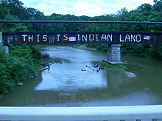
Garden River First Nation, near Sault Ste. Marie, Ontario
(near where I grew up)
Robinson Huron Treaty in 1850, Ojibwa band

Slide 5
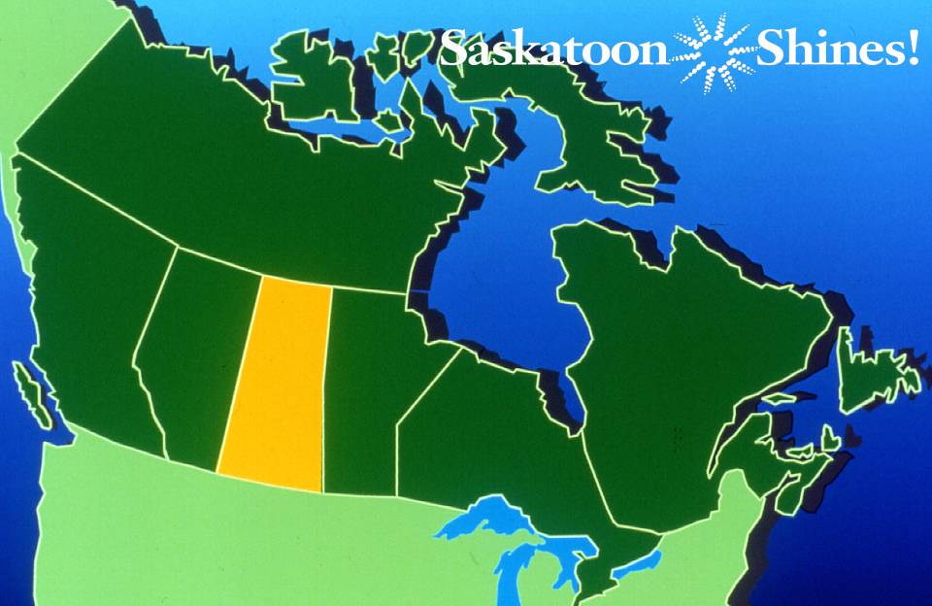
Saskatchewan
*
*
*

Slide 6
APA Workshop:
Main Changes in APA (2020) 7th edition
and Common APA Errors
By Arlene Kent-Wilkinson RN, CPMHN(C), BSN, MN, PhD
Brief Biography. Since 2002, Dr. Kent-Wilkinson has been on faculty at the College of Nursing, University of Saskatchewan, in Saskatoon, SK. Arlene is a tenured Professor who teaches in the areas of mental health and addiction, forensic nursing, and Indigenous health issues at the graduate level.
In 1997 Arlene started teaching the forensic nursing courses she developed online, and found that she needed to develop an APA tool where she could give the students the most amount of feedback without writing out each time what the error was, therefore the APA common errors checklist was first developed. For the last 10+ years, Arlene has been holding annual writing workshop for graduate and undergraduate students.

Slide 7
APA Workshop
Date:
TBD
Time:
12:00 to 1300 (1 hr each)
Location:
Zoom
Facilitator:
Dr. Arlene Kent-Wilkinson (Saskatoon) Presenter

Slide 8

AGENDA for APA Workshop
Bring your APA (2020) 7th ed. manual (optional)
Overview of handouts
PRESENTATION
Setting up your File Database of References A-Z
APA Example Paper Outline (Level of Headings, Formatting)
Reference Citations in text and Reference List
Main rules APA (2020) 7th ed.

Slide 9
Handout Resources for APA Workshop
HANDOUTS
APA (2020). 7th ed. Workshop APA PPT
APA (2020). 7th ed. Common Errors Checklist #1-33
APA (2020). 7th ed. Level of Headings
APA (2020). 7th ed. 15 Main Changes from 6th ed.
APA (2020). 7th ed. Sample APA paper Outline
EVALUATION (What I Learned today)
References List

Slide 10
APA Writing Style Workshop
  Presentation Overview
  APA in 60-90 minutes
  Practical TIPS /Handouts
  Focus: Citations & References
  Remember: Scholarly writing is a “process over time”
  Remember: APA style formatting is a “process over time”
  Best way to learn APA is to “give” and to “receive” good feedback

Slide 11
APA Workshop Resources Available on
College of Nursing, USask Website
https://nursing.usask.ca/
Select on Students
Select on Scholarly Writing
Scroll down to bottom on page
https://nursing.usask.ca/scholarly-writing/overview.php
Additional APA Resources for Students

Slide 12
APA Workshop Resources Available on Website
Additional APA Resources for Students in Graduate Programs
The following APA resources and examples have been prepared by Arlene Kent-Wilkinson RN, PhD, specifically for students in our graduate programs. Undergraduate students may also find them helpful.
APA (2020) 7th ed. Tips #1-31 Common Errors (Sept 1, 2024)
APA (2020) 7th ed. Level of Headings
APA (2020) 7th ed. Main Changes from APA (2010) 6th ed.
APA (2020) 7th ed. Example Paper on Poverty Outline (Sept 1, 2024)
APA (2020) 7th ed. Writing Workshop Presentation (Sept, 2024)

Slide 13
U of S Thesis & Proposal
Thesis Preparation
Formatting requirements for Dissertations
https://students.usask.ca/graduate/thesis-preparation.php#Formatting.
Not in complete APA, but APA is required for most of the behavioural science disciplines for course assignments

Slide 14
Writing Styles or Formats
APA
American Psychological Association (generally referred to by the acronym APA)
(many manuscripts and dissertations in psychology, education, business, and the social sciences)
Style requirement of papers and dissertation at U of S for Nursing and Social Sciences
Other Styles
Chicago Style (books, magazines, newspapers, and other non-scholarly
publications)
Harvard (Writing style Format, author/year citation in body of paper, References
at the end )
MLA (literature, arts, and the humanities)
Turabian (higher education in many subjects)

Slide 15
Arrangement of Contents U of S Thesis
1. Title Page
2. Permission to Use and Disclaimer Statement
3. Abstract
4. Acknowledgements
5. Permission to Reproduce
6. Dedication
7. Table of Contents
8. Tables
9. Figures
10. List of Abbreviations
11. Body of the Thesis
12. Referencing Other Works
13. Appendices
14. Referencing and Bibliography
15. Electronic Supplements

Slide 16

APA Publication Manual (2010) 6th ed.
Latest APA (2020) Publication Manual (7th ed.)
has been out since October, 2019

Slide 17
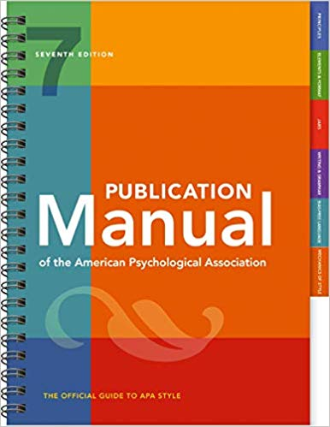
APA Publication Manual (2020) 7th ed.
American Psychological Association. (2020). Publication
manual of the American Psychological Association (7th ed.).

Slide 18
New APA (2020) Manual (7th ed.) available October 2019
NB My APA CHECKLIST was based on an earlier APA manuals.
I have updated the CHECKLIST to the APA (2020) Manual (7th ed.)
The College of Nursing policy is now that APA (2020) 7th is now required. Students may have already bought the older edition but there is lots of resources out there (online) of the main changes

Slide 19
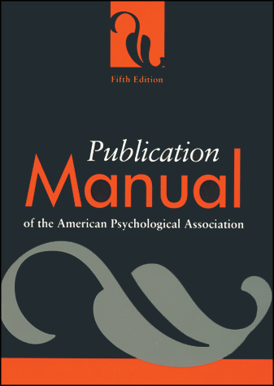
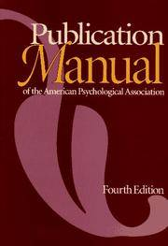
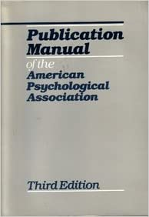
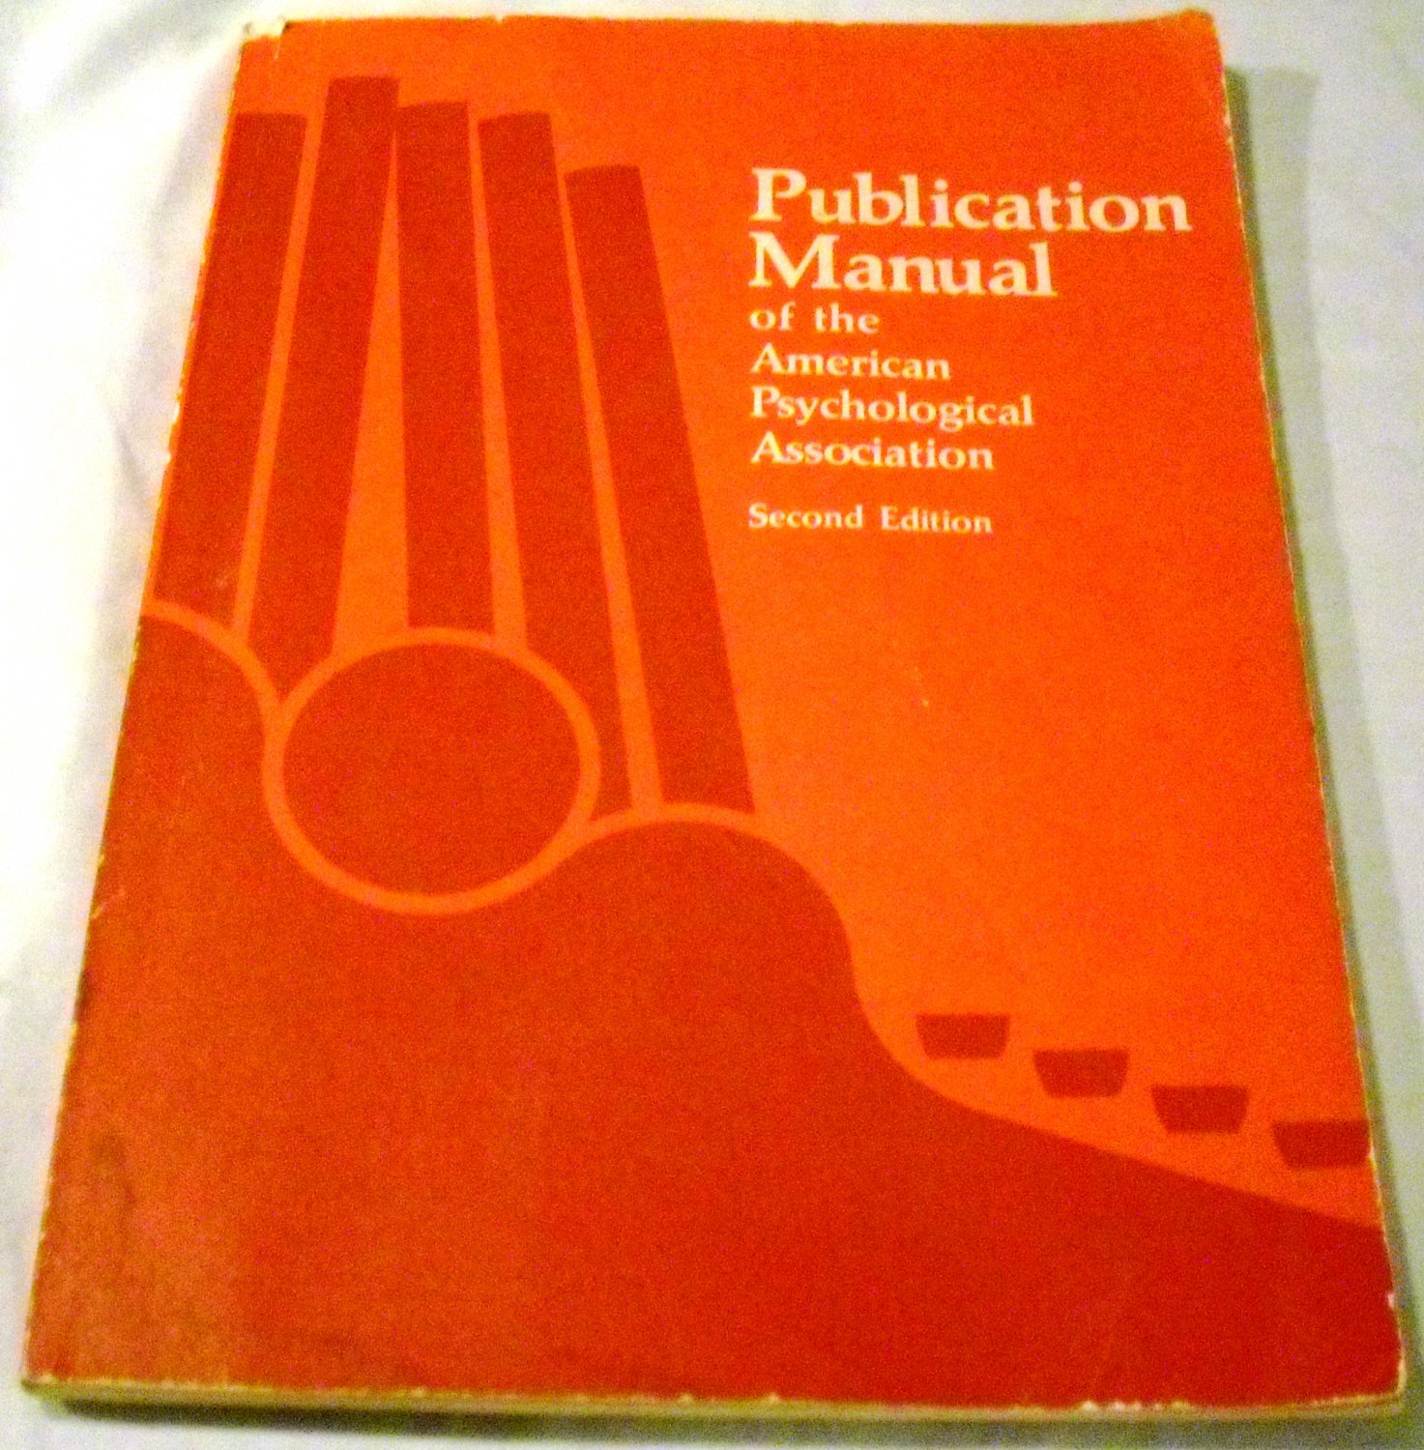
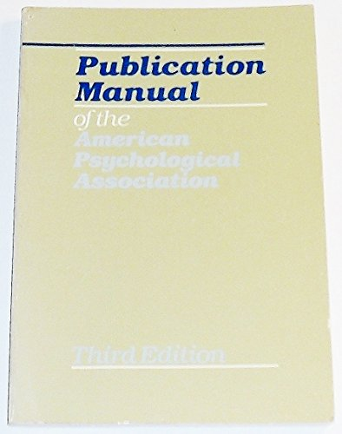
Timeline HX of APA Publication Manuals
APA (2020) 7th edition
APA (2010) 6th edition
APA (2001) 5th edition
APA (1994) 4th edition
APA (1983) 3rd edition
APA (1974) 2nd edition
APA (1952) 1st edition

Slide 20
APA Publication Manual (2020)
Twelve Chapters included for careful review:
Chapter 1: Scholarly Writing and Publishing Principles
(Chapter 1: addresses types of paper and ethical compliance (APA, 2020, pp. 3–28).
Chapter 2: Paper Elements and Format
(Chapter 2: designed to help novice users of APA Style select, format and organize paper elements
** Sample professional paper (APA, 2020, pp. 50-60). ** Sample student paper (APA, 2020, pp. 29–70).
Chapter 3: Journal Article Reporting Standards
(Chapter 3: orients users to journal article reporting standards (JARS) and included tables outlining standards for reporting quantitative, qualitative, and mixed methods research (APA, 2020, pp. 71–110).
Chapter 4: Writing Style and Grammar
(Chapter 4: provides guidance on writing style and grammar. The singular “they” is endorsed consistent with inclusive usage. More detailed guidelines helps student avoid anthropomorphism (APA, 2020, pp. 111–130).
Chapter 5: Bias Free Language Guidelines
(Chapter 5: present bias free language guidelines to encourage authors to write about people with inclusivity and respect (updates to age, disability, gender, racial and ethnic identity, (APA, 2020, pp. 131 – 152).
Chapter 6: Mechanics of Style
(Chapter 6: covers the mechanics on style including punctuation, capitalization, abbreviation, numbers and statistics in text (APA, 2020, pp. 153–194).

Slide 21
APA Publication Manual (2020) (cont.)
Chapter 7: Tables and Figures
Chapter 7: present guideline on creating table s and figures (APA, 2020, pp. 195–252).
Chapter 8: Works Credited in the Text
Chapter 8: addresses appropriate levels of citation as well as plagiarism, self plagiarism and other unethical writing practices (APA, 2020, pp. 253–280).
Chapter 9: Reference List
Chapter 9: examines the four elements of reference list entry (author, date, title, and source) (APA, 2020, pp. 281–312).
Chapter 10: Reference Examples
Chapter 10: provides more than 100 examples of APA Style references, each with accompanying parenthetical and narrative in-text citations (APA, 2020, pp. 313–354).
Chapter 11: Legal Reference
Chapter 11: presents expanded and updated legal reference examples (APA, 2020, pp. 355–370).
Chapter 12: Publication Process
Chapter 12: provides guidance on the publication process (APA, 2020, pp. 371–395).

Slide 22
APA Writing Style Workshop
Practical Tips as your start your Graduate Degree
Start your own database or file of your topic references
A-Z Total References and Topic References
Always put page numbers on every word document/ppt slides
Include a title page and your name on every assignment you submit
Label your file with your full name on it assign # and date submitted.
Before submitting your paper:
Reference every source
Check that every reference cited in body of paper is included in
the references
Check that the Author and year citation in text matches exactly
the Author and year in the Reference
Check that your References are in Alpha order

Slide 23
References - Database
When your start your Graduate Degree –
Start your Reference Database
References A-Z (Alpha order)
References by TOPIC A-Z

Slide 24
References – Database A-Z
A
American Psychological Association. (2010). Publication manual of the
American Psychological Association (6th ed.).
American Psychological Association. (2020). Publication manual of the
American Psychological Association (7th ed.).

Slide 25
References – Database A-Z
C
Canadian Nurses Association. (2017). Code of ethics for registered nurses. .
https://www.cna-aiic.ca/en/nursing/regulated-nursing-in-canada/nursing-ethics
Canadian Nurses Association. (2018, March). Promoting cultural competence in nursing (Position statement).
https://www.cna-aiic.ca/-/media/cna/page-content/pdf- en/position_statement_promoting_cultural_competence_in_nursing.pdf?l a=en&hash=4B394DAE5C2138E7F6134D59E505DCB059754BA9
Canadian Institutes of Health Research. (2013). CIHR guidelines for health research
involving Aboriginal people.
http://www.cihr-irsc.gc.ca/e/29134.html

Slide 26
References – Database A-Z
C
Creswell, J. W. (2018). Qualitative inquiry and research design: Choosing
among five approaches (4th edition). Sage Publications.
Creswell, J. W. (2018). Research design: Qualitative, quantitative, and
mixed methods approaches (5th edition). Sage Publications.

Slide 27
References – Database A-Z
D
Department of Justice. (2018a). Cannabis legalization and regulation.
Government of Canada. https://www.justice.gc.ca/eng/cj-
jp/cannabis/

Slide 28
References - Database A-Z
G
Government of Canada. (2015). Truth and Reconciliation Commission of Canada: Calls to action.
https://publications.gc.ca/collections/collection_2015/trc/IR4-8-2015-eng.pdf
Government of Canada. (2018). Social determinants of health and health equalities.
https://www.canada.ca/en/public-health/services/health-promotion/population-health/what
determines-health.html

Slide 29
References - Database A-Z
O
Office of the Correctional Investigator. (2023, June 30). Annual report of the Office of the
Correctional Investigator 2022-2023 (by Ivan Zinger, Correctional Investigator).
https://oci-bec.gc.ca/sites/default/files/2023- 10/Annual%20Report%20EN%20%C3%94%C3%87%C3%B4%20Web.pdf

Slide 30
References – Database A-Z
S
Statistics Canada. (2017, November 25). Aboriginal peoples in Canada: Key results from the 2016 Census. Government of Canada.
https://www150.statcan.gc.ca/n1/daily-quotidien/171025/dq171025a-
eng.htm?indid=14430-1&indgeo=0
Statistics Canada. (2022, October 3). Statistics on Indigenous Peoples
(2021 census of population). Government of Canada.
https://www.statcan.gc.ca/en/subjects-start/indigenous_peoples

Slide 31
References – Database A-Z
T
Truth and Reconciliation Commission of Canada. (2015a). Canada’s residential schools: The history.
http://www.myrobust.com/websites/trcinstitution/File/Reports/Volume_1_H
istory_Part_1_English_Web.pdf
Truth and Reconciliation Commission of Canada. (2015b). Honouring the truth, reconciling for the
future: Summary of the final report of the Truth and Reconciliation Commission of Canada.
http://nctr.ca/assets/reports/Final%20Reports/Executive_Summary_English_Web.pdf
More correct author is Government of Canada
Truth and Reconciliation Commission of Canada. (2015c). Truth and Reconciliation Commission of
Canada: Calls to action. https://www2.gov.bc.ca/assets/gov/british-columbians-our-
governments/indigenous-people/aboriginal-peoples-documents/calls_to_action_english2.pdf

Slide 32
References – Database - By TOPICS A-Z
A
B
C
Cultural Competence/Safety/Humility
D
E
Ethics
G
Government Reports
H
Harm Reduction Model

Slide 33
References – Database By TOPICS A-Z
I
Indigenous Education
J
K
L
M
Media Articles
N
O
P
Q
R
Residential Schools

Slide 34
References – Database by Topic A-Z
S
Statistics
T
U
V
Videos
W
Women
X
Y
Z

Slide 35
References – Database A-Z by TOPIC
C
Cultural Competence/Safety/Humility
Canadian Nurses Association. (2018, March). Position statement: Promoting
cultural competence in nursing.
https://www.cna-aiic.ca/-/media/cna/page-content/pdf- en/position_statement_promoting_cultural_competence_in_nursing.pdf?l a=en&hash=4B394DAE5C2138E7F6134D59E505DCB059754BA9
First Nations Health Authority. (2019). Cultural safety and humility.
https://www.fnha.ca/Documents/FNHA-PCMHW-Summit-2019- Presentation-Dr-Becky-Palmer-Cultural-Safety-and-Humility.pdf

Slide 36
References – Database A-Z by TOPIC
E
Ethics
Canadian Nurses Association. (2017). Code of ethics for registered nurses.
https://www.cna-aiic.ca/en/nursing/regulated-nursing-in-canada/nursing-ethics

Slide 37
References – Database A-Z by TOPIC
H
Harm Reduction Model
Canadian Nurses Association, Canadian Association of Nurses in HIV/AIDS Care, and
Harm Reduction Nurses Association. (2018, March). Joint position statement:
Harm reduction and substance use.
https://www.cna-aiic.ca/-/media/cna/page-content/pdf-
en/joint_position_statement_harm_reduction_and_substance_use.pdf?la
=en&hash=A2BC6D6FADBEF2206AF2DDE40A1654ADAA2FCD79
Harm Reduction Nurses Association. (2019, September 15). Position statement: Harm
reduction education in baccalaureate nursing programs.
http://www.hrna-aiirm.ca/wp-
content/uploads/2019/09/HRNA_PS_Baccalaureate_EN_190917.pdf

Slide 38
References – Database TOPICS A-Z
R
Research
Canadian Institutes of Health Research. (2013). CIHR guidelines for health research involving Aboriginal people.
http://www.cihr-irsc.gc.ca/e/29134.html
Creswell, J. W. (2018). Qualitative inquiry and research design: Choosing among five approaches (4th edition). Sage Publications.
Creswell, J. W. (2018). Research design: Qualitative, quantitative, and mixed methods approaches (5th edition). Sage Publications.

Slide 39
Title of your Paper
How important is the title of your paper/article?
Kent-Wilkinson, A. (1993). After the crime, before the trial.
Canadian Nurse, 89(11), 23–26.

Slide 40
Title of your Paper
How important is the title of your paper/article?
Kent-Wilkinson, A. (1993). After the crime, before the trial.
Canadian Nurse, 89(11), 23–26.
Does the title reflect what the paper is about?
Is this article about nursing?

Slide 41
Title of your Paper
How important is the title of your paper/article?
Kent-Wilkinson, A. (1993). After the crime, before the trial.
Canadian Nurse, 89(11), 23–26.
Does the title reflect what the paper is about?
Is this article about nursing?
Would this article come up in a nursing or health database?

Slide 42
Title of your Paper
How important is the title of your paper/article?
Kent-Wilkinson, A. (1993). After the crime, before the trial.
Canadian Nurse, 89(11), 23–26.
Does the title reflect what the paper is about?
Is this article about nursing?
Would this article come up in a nursing or health database?
Is this paper about the role of the nurse?

Slide 43
Title of your Paper
How important is the title of your paper/article?
Kent-Wilkinson, A. (1993). After the crime, before the trial.
Canadian Nurse, 89(11), 23–26.
Does the title reflect what the paper is about?
Is this article about nursing?
Would this article come up in a nursing or health database?
Is this paper about the role of the nurse?
Better title would have been:
Forensic psychiatric nursing: The philosophy of our practice.

Slide 44
APA References
Reference
American Psychological Association. (2020). Publication manual of the
American Psychological Association (7th ed.).
Parts of a Reference (books or reports)
Author(s) (last name, first initials)
(Year) (period before and after the year)
Title of book or report (italic) (do not capitalize every word unless proper name)
edition (parenthesis, small “e” for edition, capital “E” for Editors)
Publisher (unless the publisher is also same/as the author.
New recommendation
APA citation should be included in the inside cover of every publication/report

Slide 45
APA References
Reference
Amundsen, C., & Kent-Wilkinson, A. (2020, November 15). Prenatal evacuation: Addressing
the birth customs and perinatal care needs of Indigenous women in Northern Canada.
International Journal of Nursing Student Scholarship, 7(49), 1–13.
https://journalhosting.ucalgary.ca/index.php/ijnss/article/view/71469
Luznar-Purdy, N., & Kent-Wilkinson, A. (2021, May). A Japanese Canadian nurse reflects on
cultural competency, humility, and safety in caring for an Indigenous patient.
International Journal of Nursing Student Scholarship, 8(55), 1–16.
https://journalhosting.ucalgary.ca/index.php/ijnss/article/view/72642
Parts of a Reference (Journal articles)
Author(s) (last name, first initials)
Year (period before and after the year)
Title of article
Title of Journal (italic) (capitalize journal title)
Volume(Number), page range. Italic volume only
Include url or DOI link. http://dx.doi.org/ or https://doi.org
Use tab indent and consistent font – either Times Roman 12 font or Calibri 12 font

Slide 46
APA Common Errors
Is the APA Correct?
Kent-Wilkinson, A (1993). After the crime, before the trial.
Canadian Nurse, 89 (11), 23-26

Slide 47
APA Common Errors
Is the APA Correct? Where are the 7 main errors?
Kent-Wilkinson, A (1993). After the crime, before the trial.
Canadian Nurse, 89 (11), 23-26

Slide 48
APA Common Errors
Is the APA Correct? Where are the 7 main errors?
Kent-Wilkinson, A (1993). After the crime, before the trial.
Canadian Nurse, 89 (11), 23-26 no period at the end

Slide 49
APA Common Errors
Incorrect APA
Kent-Wilkinson, A (1993). After the crime, before the trial.
Canadian Nurse, 89 (11), 23-26
Correct APA
Kent-Wilkinson, A. (1993). After the crime, before the trial.
Canadian Nurse, 89(11), 23–26.

Slide 50
APA Common Errors
Incorrect APA
Kent-Wilkinson, A (1993). After the crime, before the trial.
Canadian Nurse, 89 (11), 23-26
Correct APA
Kent-Wilkinson, A. (1993). After the crime, before the trial.
Canadian Nurse, 89(11), 23–26.

Slide 51
APA Tips 1-33,
Checklist Most Common Errors
Handout
#01-04, APA Cover & Abstract Page
#05-08, APA Body of Paper: Title, Intro, level of heading
#09-19, APA Body of Paper: Reference citations; writing rules
#20-31, APA References Pages
#32 APA Powerpoint Presentations: Reference citations, & List
#33 Avoid Predatory Journals

Slide 52
APA Cover Page/Abstract/Font #1-4
APA Tips # 1a Title on Cover page
APA Tips #1b Running head: DEMENTIA
APA Tips #1c Page Numbers (top right)
APA Tips #2(a-b) Double Space/Cover Page/Line spaces
APA Tips #3 Font (12 Times Roman)
APA Tips #4(a-b) Abstract & Keywords

Slide 53
APA Body of Paper #5-8
APA Tips #5 Title of Paper (Body of paper)
APA Tips #6a Introduction (not a heading) paragraph
APA Tips #7(a-d) Paragraphs
APA Tips #8(a-e) Level of Headings

Slide 54
APA Reference Citation & Writing rules #9-19
APA Tips #09(a-l) Citing References in Text
APA Tips #10(a-d) Authors: One, Two, Multiple; Same author multiple years
APA Tips #11(a-d) Acronyms/Abbreviations
APA Tips #12(a-b) Capitalization
APA Tips #13(a-b) Diagrams
APA Tips #14(a-c) Numbers/Bullets
APA Tips #15 Quotations
APA Tips #16(a-c) Avoid these writing errors
anthropomorphism, jargon, in regard to (singular is correct)
APA Tips #17(a-b) Person/Active Passive Voice
APA Tips #18(a-c) Prepositions (avoid using “It” to start a sentence; singular they)
APA Tips #19 (a-b) Pronouns (avoid It); Gender

Slide 55
APA Reference Pages #20-31
APA Tips #20(a-j) Formatting
APA Tips #21(a-h) Authors
APA Tips #22(a-c) Year and Date in Reference
APA Tips #23(a-d) Italic (What to Italic?)
APA Tips #24(a-d) Abbreviations/Acronyms in References
APA Tips #25(a) Ampersand “&” not “and” in References
APA Tips #26(a-e) Capitalization
APA Tips #27(a-d) Punctuation (Periods, Commas in References)
APA Tips #28(a-d) Spaces in References
APA Tips #29(a-d) Page range in Reference List
APA Tips #30(a) Publisher Location (no longer needed) just publisher
APA Tips #31(a-e) Retrieval/DOI Links/URL (no longer use- Retrieved from)
APA Tips #32 (a-d) PPT Slides
APA Tips #33 Predatory Journals, Publishers, Conferences

Slide 56
15 Main Changes in APA (2020) 7th edition
Sample ‘Student Paper’
Running head.
Bold.
Typeface/Font.
APA Level of Headings.
Three or More Authors in Text.
Authors (Up to 20) in Reference.
Location of the Publisher.
‘Retrieved from’ or ‘Accessed from’.
Hyperlink (DOI).
Live URL/DOI.
Inclusive and Bias-free Language.
Anthropomorphism.
How to Reference: Media, PPTs, YouTube.
Avoiding Predatory/Deceptive Journals.

Slide 57
15 Main Changes in APA (2020) 7th edition
1. Sample ‘Student Paper’ Tip #1
(APA 2020, pp. 61–67).
‘Running head’, ‘Abstract’ and ‘Authors Note’ not required for student papers, unless the instructor or Institution requires (APA 2020, p. 30, 35, 37, 38, 61).
Sample ‘Professional paper’ (APA 2020, pp. 50–60).

Slide 58
15 Main Changes in APA (2020) 7th edition
2. Running head: Tip #1b
No longer include label ‘Running head’ on Title Page
(APA, 2020, p. 37).
There can now be an extra line space after the heading
(APA, 2020, p. 32, 50, 61).
Page Numbers – top right
Page Margins – 1” top, bottom, right and left

Slide 59
15 Main Changes in APA (2020) 7th edition
3. Bold. Tip #1a, 4a, 5, 20c
‘Title of the Paper’, ‘Abstract’, and ‘References’
(APA, 2020, p. 40, 58, 66).
Paper Title also appears at the top of the first page of text
(APA, 2020, p. 32).

Slide 60
15 Main Changes in APA (2020) 7th edition
4. Typeface/Font. Tip #3
A variety of font choices are permitted in 7th edition APA (2020, p. 44).
Check with your publisher, instructor, or institution for any requirements regarding font (APA, 2020, p. 44). In APA (2010), 6th edition “the preferred typeface for APA publications was Times New Roman with 12-point font size” (p. 228). But this has changed in 7th ed.

Slide 61
15 Main Changes in APA (2020) 7th edition
5. APA Level of Headings. Tips #8a, 8b, 8c, 8d, 8e
New 3rd level heading in 7th ed. (APA, 2020, pp. 48–49).
Flush Left, Bold Italic, Title Case Heading 3rd level heading.
NB: In all 5 level headings, every word is now in Bold and in ‘Title Case Heading’ meaning every letter in each word in each heading is now Capitalized (APA, 2020, pp. 47–49).
See example of all 5 Level of Headings below.

Slide 62
15 Main Changes in APA (2020) 7th edition
5. APA Level of Headings. Tips #8a, 8b, 8c, 8d, 8e
APA (2020) 7th edition Level of Headings
NB the new 3rd level (italic) NB that every Level of Heading is Bold NB that every Main Word in every Level is Upper Case or Title Case Heading
Level 1 | Centered, Bold, Title Case Heading Text begins as a new paragraph.
Level 2 | Flush Left, Bold, Title Case Heading Text begins as a new paragraph.
Level 3 | Flush Left, Bold Italic, Title Case Heading (New in 7th ed., APA, 2019). Text begins as a new paragraph.
Level 4 | Indented, Bold, Title Case Heading, Ending With a Period. Text begins on the same line and continues as a regular paragraph.
Level 5 | Indented, Bold Italic, Title Case Heading, Ending With a Period. Text begins on the same line and continues as a regular paragraph.
 | (APA, 2020, p. 47–48).

Slide 63
15 Main Changes in APA (2020) 7th edition
6. Three or More Authors in Text. Tip #10b
Write out only the first author’s last name, then ‘et al.,’
Use ‘et al.,’ for the first and every subsequent time cited (APA, 2020, p. 266).

Slide 64
6. Three or More Authors in Text. Tip #10b
What is the error?
Registered nurses were interviewed who participated in the study abroad program within the late two to fifteen years (Dietrich Leurer, Kent-Wilkinson, Luimes, Murray, Squires, Ferguson, & Dell, 2020).

Slide 65
6. Three or More Authors in Text. Tip #10b
What is the error?
Registered nurses were interviewed who participated in the study abroad program within the late two to fifteen years (Dietrich Leurer, Kent-Wilkinson, Luimes, Murray, Squires, Ferguson, & Dell, 2020).
APA tip # 10b – use et al the first time and every time cited
(APA, 2020, p. 51, 59, 266)

Slide 66
6. Three or More Authors in Text. Tip #10b
Correct?
Registered nurses were interviewed who participated in the study abroad program within the last two to fifteen years (Dietrich Leurer et al., 2020).

Slide 67
15 Main Changes in APA (2020) 7th edition
7. Authors (Up to 20) in Reference. Tip #21d
Include up to 20 Authors (last name and initials);
For 2 to 20, use ‘&’ ampersand before last author;
For 21 or more authors, include the first 19 author’s names, insert an ellipsis (but no ampersand) and then add the final author’s name (APA 2020, p. 286, 317).

Slide 68
15 Main Changes in APA (2020) 7th edition
7. Authors (Up to 20) in Reference List. Tip #21d
APA (2010) 6th ed. was For 6 and more authors
Cite the first 6 authors only, an ellipsis … final author
Smith, B., Jones, G., White, J., Nelson, T., Kent, D., Bell, C., … Hall, D. (2020).
APA (2020) 7th ed. –
Up to 20 Authors – cite all authors and then & before the Final Author (example for 3 to 20 authors) 10 below
Martin, G., Jones, G., White, J., Nelson, T., Kent, D., Bell, C., Smith, B., Wilson, S., Snow, F., & Carter, D. (2020).
APA (2020) 7th ed. –
More than 20 Authors means only 20 are listed (Cite 1st 19 then use ellipsis … and then final author.
Smith, B., Jones, G., White, J., Nelson, T., Kent, D., Bell, C., Wilson, S., Snow, F., Martin, G., Carter, D., Evans, A.,
Green, R., Wallace, A., Collins, I., Barton, M., Boyle, E., Harris, R., Barber, D., Elliot, D., … Hall, D. (2020).

Slide 69
15 Main Changes in APA (2020) 7th edition
8. Location of the Publisher. Tip #30a
No longer include the city, province/state in the Reference
(APA, 2020, p. 322).
But still include the Publisher.

Slide 70
Location: Publisher
Incorrect
Canadian Nurses Association. (2017). Code of ethics for registered nurses.
Ottawa: CNA. Retrieved from
https://www.cna-aiic.ca/en/nursing/regulated-nursing-in-canada/nursing-ethics
Correct (APA 2010, 6th edition)
Canadian Nurses Association. (2017). Code of ethics for registered nurses.
Ottawa, ON: Author. Retrieved from
https://cna-aiic.ca/html/en/Code-of-Ethics-2017-Edition/index.html#
Correct (APA 2020, 7th edition)
Canadian Nurses Association. (2017). Code of ethics for registered nurses.
https://www.cna-aiic.ca/en/nursing/regulated-nursing-in-canada/nursing-ethics

Slide 71
Location: Publisher
Incorrect
Creswell, J. W. (2014). Research design: Qualitative, quantitative and mixed
methods approaches (4th ed.). Thousand Oaks, CA: Sage.
Correct (APA, 2020, 7th ed.)
Creswell, J. W. (2014). Research design: Qualitative, quantitative and mixed
methods approaches (4th ed.). Sage.

Slide 72
Location: Publisher
Incorrect:
WHO. (2015). HIV/AIDS factsheet. Geneva: WHO.
Retrieved from http://www.who.int/mediacentre/factsheets/fs360/en/
Correct: APA (2010) 6th
World Health Organization. (2015). HIV/AIDS factsheet. Geneva, CH: Author.
Retrieved from http://www.who.int/mediacentre/factsheets/fs360/en/
Correct: APA (2020) 7th
World Health Organization. (2015). HIV/AIDS factsheet.
http://www.who.int/mediacentre/factsheets/fs360/en/
See APA Tip #24b – Write abbreviations out in full (APA, 2019, p. 324)
See APA Tip #30a – location of published no longer needed (APA, 2019, p. 322, 324, 330-331, 334-335, 297).

Slide 73
15 Main Changes in APA (2020) 7th edition
9. ‘Retrieved from’ or ‘Accessed from’. Tip #31a
Do not include before the url (APA, 2020, pp. 299–300).
Unnecessary wording
Exception of when to include a retrieval or accessed date:
If the year is (n.d.) only then do you include the retrieval date
Example:
Meriam Webster Dictionary. (n.d.). Allyship. Accessed June 2, 2020.
https://www.merriam-webster.com/dictionary/allyship

Slide 74
15 Main Changes in APA (2020) 7th edition
9. ‘Retrieved from’ or ‘Accessed from’. Tip #31a
Correct APA (2010) 6th ed.
Canadian Nurses Association. (2017). Code of ethics for registered nurses.
Retrieved from https://www.cna-aiic.ca/~/media/cna/page- content/pdf-en/code-of-ethics-2017-edition-secure-interactive
Now correct – APA (2020) 7th ed.
Canadian Nurses Association. (2017). Code of ethics for registered nurses.
https://www.cna-aiic.ca/en/nursing/regulated-nursing-in-canada/nursing-ethics

Slide 75
15 Main Changes in APA (2020) 7th edition
10. Hyperlink (DOI). Tip #31b
Use doi hyperlink for direct link to the article (APA, 2020, p. 300).

Slide 76
doi prefix (new in APA, since 2014)
https://dx.doi.org/ or https://doi.org/ before the /10
American Psychiatric Association. (2014, July 14). How to use the new doi format
in APA style (By Jeff Hume-Pratuch). APA Style Blog. http://blog.apastyle.org/apastyle/digital-object-identifier-doi/
Incorrect
doi: 10.1016/j.nedt.2015.03.012
Correct
Kent-Wilkinson, A., Dietrich Leurer, M., Luimes, J., Ferguson, L., & Murray, L. (2015). Study abroad: Exploring factors influencing nursing students’ decisions to apply for clinical placements in international settings. Nurse Education Today, 35(8), 941–947. https://doi.org/10.1016/j.nedt.2015.03.012

Slide 77
doi prefix (new in APA, since 2014)
Find the 1 different error in this citation
Kent-Wilkinson, A., Dietrich Leurer, M., Luimes, J., Ferguson, L., & Murray, L.
(2015). Study abroad: Exploring factors influencing nursing students’
decisions to apply for clinical placements in international settings. Nurse Education Today, 35(8), 941–947.
doi: https://doi.org/10.1016/j.nedt.2015.03.012

Slide 78
doi prefix (new in APA, since 2014)
Here is the 1 different error in this citation
Kent-Wilkinson, A., Dietrich Leurer, M., Luimes, J., Ferguson, L., & Murray, L.
(2015). Study abroad: Exploring factors influencing nursing students’ decisions to apply for clinical placements in international settings. Nurse
Education Today, 35(8), 941–947.
doi: https://doi.org/10.1016/j.nedt.2015.03.012
See APA Tip: #31b – do not include doi before the link
(APA, 2020, p. 58-59, 66-67, 284, 298-300.

Slide 79
15 Main Changes in APA (2020) 7th edition
11. Live URL/DOI. Tip #31c
Links should be live if the work is to be published or read online.
In 7th ed. (APA, 2020), either underline or blue font in the Reference pages is acceptable, or plain font and no underline is acceptable (p. 299).

Slide 80
15 Main Changes in APA (2020) 7th edition
11. Live URL/DOI. Tip #31c
Wikipedia. (2020a, May 10). The StarPhoenix. https://en.wikipedia.org/wiki/The_StarPhoenix
Wikipedia. (2020b, May 16). Verney family of Middle Claydon.
https://en.wikipedia.org/wiki/Verney_family_of_Middle_Claydon
Wikipedia. (2020c, June 21). Claydon House.
https://en.wikipedia.org/wiki/Claydon_House
Wikipedia. (2020d, June 26). Frances Parthenope Verney.
https://en.wikipedia.org/wiki/Frances_Parthenope_Verney
World Health Organization. (2020a, January). Year of the nurse and the midwife 2020.
https://www.who.int/campaigns/year-of-the-nurse-and-the-midwife-2020
World Health Organization. (2020b, March 11). Timeline of WHO’s response to COVID-19.
https://www.who.int/news/item/29-06-2020-covidtimeline

Slide 81
15 Main Changes in APA (2020) 7th edition
11. Live URL/DOI. Tip #31c
Wikipedia. (2020a, May 10). The StarPhoenix. https://en.wikipedia.org/wiki/The_StarPhoenix
Wikipedia. (2020b, May 16). Verney family of Middle Claydon.
https://en.wikipedia.org/wiki/Verney_family_of_Middle_Claydon
Wikipedia. (2020c, June 21). Claydon House.
https://en.wikipedia.org/wiki/Claydon_House
Wikipedia. (2020d, June 26). Frances Parthenope Verney.
https://en.wikipedia.org/wiki/Frances_Parthenope_Verney
World Health Organization. (2020a, January). Year of the nurse and the midwife 2020.
https://www.who.int/campaigns/year-of-the-nurse-and-the-midwife-2020
World Health Organization. (2020b, March 11). Timeline of WHO’s response to COVID-19.
https://www.who.int/news/item/29-06-2020-covidtimeline

Slide 82
15 Main Changes in APA (2020) 7th edition
12. Inclusive and Bias-free Language. Tip #19b
The use of the singular “they” is inclusive of all people, and helps writers avoid making assumptions about gender and is part of APA Style.
When using the singular “they” use the forms “they”, “them”, “theirs”, and “themselves”.
Examples
Each participant turned in their questionnaire.
Jamie shared their experience as a genderqueer person.
Rowan, a transgender person, helped themselves (or themself) to the free coffee (APA, 2020, p. 121).

Slide 83
15 Main Changes in APA (2020) 7th edition
13. Anthropomorphism. Tip #16a
See additional examples to clarify avoidance of…
(APA, 2020, p. 117).

Slide 84
Anthropomorphism (Avoidance of)
Do not attribute human characteristics to animals or inanimate sources (APA , 2020, p. 117). See APA Tip #16a
Incorrect
The study identified 46 undergraduate nursing degree programs across Canada .....
This paper will address ….
Correct
Vandyk (2015) identified 46 undergraduate nursing degree programs across Canada...
The author will address…

Slide 85
15 Main Changes in APA (2020) 7th edition
14. How to Reference: Tip #20f
Powerpoint Slides
Kent-Wilkinson, A. (2023, October 23). Main changes in APA 7th edition and
common APA errors [PowerPoint slides]. College of Nursing,
University of Saskatchewan, Saskatoon, Saskatchewan
https://nursing.usask.ca/scholarly-writing/overview.php
[Webinar]

Slide 86
15 Main Changes in APA (2020) 7th edition
14. How to Reference: Tip #20f
YouTube
Cox, E. (2020, May 14). What is a coronavirus? [Video, 5: 15 min]. TEDEd.
  https://www.bing.com/videos/search?q=YouTube+Covid&view=detail&mid=4F33387DB88047E91CAF4F33387DB88047E91CAF&FORM=VIRE

Slide 87
15 Main Changes in APA (2020) 7th edition
15. Avoiding Predatory/Deceptive Journals. Tip #31e
See common characteristics of predatory/deceptive journals
(APA, 2020, pp. 374–376).

Slide 88
15 Main Changes in APA (2020) 7th edition
15. Avoiding Predatory/Deceptive Journals. Tip #31e
Publisher aggressively solicit manuscripts and charge fees without providing services to do so.
Open access journals that charge author fees for publication are not inherently predatory, but predatory journals commonly use this model.
Characteristics:
Informal solicitation:
Hidden publisher or website:
Lack of rigorous evaluation:
Lack of transparency:
Poor reputation:
Nonstandard submission processes:
Lack of indexing in databases (APA, 2020, pp. 374–376).

Slide 89
Abbreviations in Text and References
Abbreviations
What are the 3 APA Errors here?
Incorrect APA
Text
“While the numbers can tell you a lot about the coronavirus, the case numbers only tell part of the story” (CBC News, 2020, para. 1). “Daily numbers give a sense of whether the number of new infections is growing and how quickly” (CBC News, 2020, para. 4).
CBC News (2020) in their Tracking The Coronavirus provides an excellent website link for tracking the spread of the coronavirus in Canada through daily tables and charts for each province since March, 2020.
Reference
CBC News. (2020). Tracking the coronavirus.
https://newsinteractives.cbc.ca/coronavirustracker/

Slide 90
Abbreviations in Text and References
Abbreviations
What are the 3 APA Errors here?
Incorrect APA
Text
“While the numbers can tell you a lot about the coronavirus, the case numbers only tell part of the story” (CBC News, 2020, para. 1). “Daily numbers give a sense of whether the number of new infections is growing and how quickly” (CBC News, 2020, para. 4).
CBC News (2020) in their Tracking The Coronavirus provides an excellent website link for tracking the spread of the coronavirus in Canada through daily tables and charts for each province since March, 2020.
Reference
CBC News. (2020). Tracking the coronavirus.
https://newsinteractives.cbc.ca/coronavirustracker/

Slide 91
Abbreviations in Text and References
Abbreviations Tip 9h, 11a, 11b
Write out in full the first time cited, subsequently can use abbreviation; no abbreviations at the beginning of a sentence.
Incorrect APA
Text
“While the numbers can tell you a lot about the coronavirus, the case numbers only tell part of the story” (CBC News, 2020, para. 1). “Daily numbers give a sense of whether the number of new infections is growing and how quickly” (CBC News, 2020, para. 4).
CBC News (2020) in their Tracking The Coronavirus provides an excellent website link for tracking the spread of the coronavirus in Canada through daily tables and charts for each province since March, 2020.
Reference
CBC News. (2020). Tracking the coronavirus.
https://newsinteractives.cbc.ca/coronavirustracker/

Slide 92
Abbreviations in Text and References
Abbreviations Tip 11a, 11b, 24b
Write out in full the first time cited, subsequently can use abbreviation; no abbreviations at the beginning of a sentence.
Incorrect APA
Text
“While the numbers can tell you a lot about the coronavirus, the case numbers only tell part of the story” (CBC #11a News, 2020, para. 1). “Daily numbers give a sense of whether the number of new infections is growing and how quickly” (CBC News, 2020, para. 4).
CBC 11b News (2020) in their Tracking The Coronavirus provides an excellent website link for tracking the spread of the coronavirus in Canada through daily tables and charts for each province since March, 2020.
Reference
24b CBC News. (2020). Tracking the coronavirus.
https://newsinteractives.cbc.ca/coronavirustracker/

Slide 93
Abbreviations in Text and References
Abbreviations APA Tips# 9h, 11a, 11b, 24b
Write out in full the first time cited, subsequently can used abbreviation; no abbreviations at the beginning of a sentence.
Correct APA (2020)
Text
“While the numbers can tell you a lot about the coronavirus, the case numbers only tell part of the story” (Canadian Broadcasting Corporation [CBC] News, 2020, para. 1). “Daily numbers give a sense of whether the number of new infections is growing and how quickly” (CBC News, 2020, para. 4).
Canadian Broadcasting Company News (2020) in their Tracking The Coronavirus provides an excellent website link for tracking the spread of the coronavirus in Canada through daily tables and charts for each province since March, 2020.
Reference
Canadian Broadcasting Corporation News. (2020). Tracking the coronavirus.
https://newsinteractives.cbc.ca/coronavirustracker/

Slide 94
Reference in Text - Errors
What are the 3 errors?
75 percent of opioid-related deaths in Canada between 2016 and 2018 were males. (Public Health Agency of Canada (PHAC), 2019)

Slide 95
Reference in Text - Errors
What are the 3 errors?
75 percent of opioid-related deaths in Canada between 2016 and 2018 were males. (Public Health Agency of Canada (PHAC), 2019)__
See APA Tip #14b – no numbers at beginning of sentence, write out or reword
(APA, 2020, p. 179).
See APA Tip #9c – Insert period after the parenthesis not before
(APA, 2020, p. 254).
See APA Tip #9h – use square brackets to avoid nested parenthesis
(APA, 2020, p. 292). [Nested missing in APA, 2019]

Slide 96
Reference in Text
Incorrect
75 percent of opioid-related deaths in Canada between 2016 and 2018 were males. (Public Health Agency of Canada (PHAC), 2019)__
Correct:
Seventy-five percent of opioid-related deaths in Canada between 2016 and 2018 were males (Public Health Agency of Canada [PHAC], 2019).

Slide 97
Reference in Text - Errors
What is the one (1) error in each Reference?
….opioid-related overdoses (Smith and Jones, 2019).
….opioid-related overdoses (Smith, & Jones, 2019).

Slide 98
Reference in Text - Errors
Incorrect is:
….opioid-related overdoses (Smith and Jones, 2019).
See APA Tip: 9g. Use “and” outside the parenthesis and “&” ampersand
inside (APA, 2020, p. 266).
….opioid-related overdoses (Smith, & Jones, 2019).
See APA Tip: 10a. Within the parenthesis and do not use comma after the
first author, if just two authors (APA, 2020, p. 266).

Slide 99
Reference in Text - Correct
Incorrect:
….opioid-related overdoses (Smith and Jones, 2019).
….opioid-related overdoses (Smith, & Jones, 2019).
Correct:
….opioid-related overdoses (Smith & Jones, 2019).
Or
Smith and Jones (2019) conducted research on opioid-related overdoses.

Slide 100
Reference in Text - Errors
Referencing Multiple Authors within the Parenthesis
What is the error here?
…outcomes (White, 2015; Nelson, 2017; Smith & Jones, 2019).

Slide 101
Reference in Text - Errors
Referencing Multiple Authors within the Parenthesis:
What is the error here?
…overdose (White, 2015; Nelson, 2017; Smith & Jones, 2019).
See APA Tip: #11d List by alpha order of the first author, not the earliest year
(APA, 2020, p. 263)

Slide 102
Reference in Text
Referencing Multiple Authors within the Parenthesis
Incorrect:
…overdose (White, 2015; Nelson, 2017; Smith & Jones, 2019).
Correct:
…overdose (Nelson, 2017; Smith & Jones, 2019; White, 2015).

Slide 103
APA Reference Errors
Reference (5 Errors)
Department of Health. (1998). Tackling Drugs to Build a Better Britain: The
Government's Ten-year Strategy for Tackling Drugs Misuse. Retrieved November 24, 2016 from:
  https://webarchive.nationalarchives.gov.uk/+/http://www.dh.gov.uk/en/P ublicationsandstatistics/Publications/PublicationsPolicyAndGuidance/D H_4006530

Slide 104
APA Reference Errors
Reference (5 Errors) Highlighted
Department of Health. (1998). Tackling Drugs to Build a Better Britain: The
Government's Ten-year Strategy for Tackling Drug Misuse. Retrieved November 24, 2016 from:
http://webarchive.nationalarchives.gov.uk/+/www.dh.gov .uk/en/Publicationsandstatistics/Publications/Publication sPolicyAndGuidance/DH_4006530
See APA Tips: #21e – who is the author- look at the url
26a - only capitalize the first word in a title
31a - no longer use “Retrieved from”

Slide 105
APA Reference Correct
Reference Corrected
Government of the United Kingdom. (1998). Tackling drugs to build a better
Britain: The government's ten-year strategy for tackling drug misuse. National Archives, Department of Health. http://webarchive.nationalarchives.gov.uk/+/www.dh.gov.uk
/en/Publicationsandstatistics/Publications/PublicationsPolicy AndGuidance/DH_4006530

Slide 106
APA Reference Errors
Reference (Find the 5 Errors)
Canadian Nurses Association (CNA). (2017) Code of Ethics for Registered Nurses.
Ottawa, ON: CNA. Retrieved from
https://www.cna-aiic.ca/en/nursing/regulated-nursing-in-canada/nursing-ethics

Slide 107
APA Reference - Correct
Incorrect:
Canadian Nurses Association (CNA). (2017). Code of Ethics for Registered
Nurses. Ottawa, ON: CNA. Retrieved from
https://www.cna-aiic.ca/en/nursing/regulated-nursing-in-canada/nursing-ethics
Correct:
Canadian Nurses Association. (2017). Code of ethics for registered nurses. https://www.cna-aiic.ca/en/nursing/regulated-nursing-in-canada/nursing-ethics

Slide 108
Reference List- Same Author
Ascending order by year
Canadian Nurses Association. (2008). Code of ethics for registered nurses.
https://www.cna-aiic.ca/~/media/cna/files/en/codeofethics.pdf
Canadian Nurses Association. (2017). Code of ethics for registered nurses.
https://www.cna-aiic.ca/en/nursing/regulated-nursing-in-canada/nursing-ethics
See APA Tip # 21a (APA, 2020, p. 303).

Slide 109
Location: Publisher
Correct: APA (2010) 6th ed.
United Nations. (2016). Convention on the rights of persons with disabilities (CRPD), 2006. New York, NY: Author. Retrieved from https://www.un.org/development/desa/disabilities/convention-on-the- rights-of-
persons-with-disabilities.html
Correct: APA (2020) 7th ed.
United Nations. (2016). Convention on the rights of persons with disabilities (CRPD), 2006.
https://www.un.org/development/desa/disabilities/convention-on-the-rights-of-
persons-with-disabilities.html
See APA Tip #30a – location of published no longer needed
(APA, 2020, p. 322, 324, 330-331, 334-335, 297).

Slide 110
Reference: Same Author and Year, Different Title
Government of Canada. (2018a). Cannabis legalization and regulation.
Department of Justice. https://www.justice.gc.ca/eng/cj-jp/cannabis/
Government of Canada. (2018b). Social determinants of health and health
equalities. https://www.canada.ca/en/public-health/services/health-
promotion/population-health/what-determines-health.html
See APA Tip # 21b - Alpha order of first word in the title
(APA, 2020, pp. 304-305).

Slide 111
APA Reference Errors
Find the 8 errors in this citation
Kent-Wilkinson, A., Dietrich Leurer, M. Luimes, J., Ferguson, L.,
Murray, L. (August, 2015) Study abroad: exploring factors influencing nursing students’ decisions to apply for clinical placements in international settings. Nurse Education Today, 35(8), 941-947. DOI:10.1016/j.nedt.2015.03.012

Slide 112
APA Reference
Here are where the 8 errors are in this citation:
Kent-Wilkinson, A., Dietrich Leurer, M. Luimes, J., Ferguson, L.,
& Murray, L. (August, 2015)_Study abroad: exploring factors influencing nursing students’ decisions to apply for clinical placements in international settings. Nurse Education Today, 35(8), 941-947. DOI:10.1016/j.nedt.2015.03.012
See APA Tips: #27b, 25, 22a, 27a, 26b, 23a, 29a

Slide 113
APA Reference Correct
Incorrect
Kent-Wilkinson, A., Dietrich Leurer, M. Luimes, J., Ferguson, L., & Murray, L.
(August, 2015)_Study abroad: exploring factors influencing nursing students’ decisions to apply for clinical placements in international settings. Nurse Education Today, 35(8), 941-947. DOI:10.1016/j.nedt.2015.03.012
Correct
Kent-Wilkinson, A., Dietrich Leurer, M., Luimes, J., Ferguson, L., & Murray, L.
(2015, August). Study abroad: Exploring factors influencing nursing students’ decisions to apply for clinical placements in international settings. Nurse Education Today, 35(8), 941–947. https://doi.org/10.1016/j.nedt.2015.03.012

Slide 114
Active or Passive Voice
APA says avoid the passive voice and use the active voice
Active: investigated
Passive: an investigation of
Active: The authors presented the results
Passive: Results were presented
Active: “We conducted the survey in a controlled setting”
Passive: “The survey was conducted in a controlled setting”
(APA, 2020, pp. 61, 73-74, 118).

Slide 115
Use of e.g., or i.e.,
e.g., for example
i.e., that is
Incorrect
(e.g. white, black, green)
Correct
(e.g., white, black, green)
See APA Tip #11d Always add a comma following i.e., and e.g.,)
(APA, 2020, p. 176)

Slide 116
It/All/this/that/ these/those
In scholarly writing, avoid use of “it”, “these” “those”
Avoid starting as sentence with “It”
Incorrect: It was shown ...
Correct: Researchers have shown...
Incorrect: It is defined as ….
Correct: Stigma is defined as ….
Eliminate ambiguity by writing: This test, that trial, those participants
better to state again what “it” is what “these” are? All what?
This/that ...needs an accompanying noun
See APA Tip# 19a, (APA, 2020, pp. 120–121).

Slide 117
It/All/this/that/ these/those
In scholarly writing, avoid use of “it”, “these” “those”
Incorrect Example
It is well known that women who come into the prison system have many co-morbid health issues.
Incorrect Example
This is the largest qualitative study of incarcerated aboriginal women in NSW, with 43 Aboriginal women taking part.

Slide 118
It/All/this/that/ these/those
In scholarly writing, avoid use of “it”, “these” “those”
Incorrect
It is well known that women who come into the prison system have many co-morbid health issues.
Correct
Women who come into the prison system have many co-morbid health issues (Reference, year).

Slide 119
It/All/this/that/ these/those
In scholarly writing, avoid use of “it”, “these” “those”
Incorrect
This is the largest qualitative study of incarcerated aboriginal women in NSW, with 43 aboriginal women taking part.
Correct
Nelson and colleague (2020) conducted the largest qualitative study of incarcerated Aboriginal (Indigenous) women in New South Wales (NSW), with 43 Aboriginal women taking part.

Slide 120
Avoid ending a sentence with an “ing” verb
Incorrect:
...and acknowledge the barriers still existing.
Correct:
...and acknowledge the barriers that continue to exist.
Avoid ending a sentence with a preposition
Incorrect:
Harm reduction means meeting the person where they are at.
Correct:
Harm reduction means meeting the person where they are.

Slide 121
Scientific Method
Basic Outline for every Research Proposal, Dissertation, or Academic Paper follows the scientific process, research process, or nursing process.
Scientific Method
There are essentially five steps in any scientific study:
Step 1 Identify the problem and explicate the purpose of the study
[Conduct a detailed literature review to give you a thorough understanding
of the research topic]
Step 2 Develop the research question(s), and if appropriate, research hypotheses
Step 3 Identify the appropriate design and methodology of the study
Step 4 Collect and analyze your data
Step 5 Interpret the results
(Dusick, 2011)

Slide 122
Scholarly Writing by Robert E. Levasseur (2009)
Levasseur, R. E. (2009). Scholarly writing. St. Augustine, FL: Mindfire Press.
http://www.mindfirepress.com/Scholarly_Writing.html
Style
American Psychological Association (APA) style
The APA publication manual spells out in great detail the requirements one of the most frequently followed sets of guidelines for scholarly writing.
Topics covered include the content and organization of a manuscript, grammar, bias in language, punctuation, spelling, capitalization, the use of italics and abbreviations, bibliographic and in-text reference citations.
You must adhere to the style guidelines specified by your institution, whether APA, Harvard, MLA Chicago, or some other, in all of your doctoral work.
For most students, learning APA is like learning a foreign language. While this is not necessarily an easy thing to do, you have no choice but to buckle down and learn APA style if you want to become a scholar. The sooner you do, the faster you will get through your doctoral program.

Slide 123
Scholarly Writing by Robert E. Levasseur (2009)
Finding Your Voice
avoid the passive voice
avoid the use of first and second person pronouns
no longer simply say “I” think this or “you” should do that
support your arguments with evidence from the literature
properly cite, to avoid charges of plagiarism
Sample A [Unacceptable]
Some say that money is a universal motivator. It is argued by others that it depends on the needs of the individual. I think the others are right, as I will explain in this essay.
Sample B [Acceptable]
Some say that money is a universal motivator. Others argue that it depends on the needs of the individual (Maslow, 1954). In this essay, the author will critically evaluate the arguments for and against money as a universal motivator, and provide a rationale based on personal experience and empirical research evidence in support of Maslow’s hierarchy-of-needs theory.
Maslow, A. (1954). Motivation and personality. New York: Harper and Row.
Sample B. cites a major work as evidence to support their opinion, more clear in making point that money is not a universal motivator, more credible, gives credit where credit due, uses active voice in comparison to Sample A which is passive voice.

Slide 124
Basic Tips about Writing a Scholarly Manuscript
Lambert, V. A., Lambert, C. E., & Tsukahara, M. (2003). Basic tips about writing a scholarly manuscript. Nursing & Health Sciences,
5(1) 1-2. http://dx.doi.org/10.1046/j.1442-2018.2003.00137.x
As editors of Nursing & Health Sciences, Lambert et al. (2003) were often asked for some basic tips:
Writing a title that poorly reflects the essence of the content
Failure to capture the reader's attention in the early sections of the manuscript.
Failure to produce what was promised in the introductory section of the text
Failure to develop ideas to completion
Lack of focus and direction of the presentation of ideas,
Complex and incomprehensible sentence structure
Lack of logical flow to the content presented
Failure to logically link the content between sentences and between paragraphs
Attention to detail; accepting critique; undertaking numerous rewrites
(Lambert et al., 2003)
(Lambert, Lambert, & Tsukahara, 2003).

Slide 125
Ex: Writing a title that poorly reflects the essence of the content
Title (Poor)
After the crime: Before the trial.
Title (Better)
“After the crime: Before the trial”: The philosophy of forensic psychiatric nursing on the forensic assessment unit.
Reference
Kent-Wilkinson, A. (1993). After the crime before the trial. The Canadian
Nurse, 89(11), 23–26. https://pubmed.ncbi.nlm.nih.gov/8299104

Slide 126
Failure to capture the reader's attention in the early sections of the manuscript.
Introduction Paragraph (Poor)
The HUB served as a building block for a situation table approach that bridges health, social and criminal justice representatives together to discuss solutions for high-risk cases (Thompson et al., 2019c).
Introduction Paragraph (Better)
Deaths from opioid overdose in Canada is a major public health crisis. “Intelligence indicates that over 4,000 opioid-related deaths in Canada can be expected in 2019 (Thompson et al., 2019d, p. 12).

Slide 127
Guidelines for writing scholarly papers (1)
Moser, J. (2012). Guidelines for writing scholarly papers. Department of History and Political
Science, Ashland University. http://personal.ashland.edu/~jmoser1/papers.html
Basic Structure:
The introductory paragraph should engage the reader’s interest by setting out clearly the question that the paper is attempting to address, how you plan to address it, and why it is worth addressing in the first place;
The thesis statement is a summation of your main point; this should generally appear at the end of the introductory paragraph;
Background information, basic material about the subject, to provide context for the reader;
The real “meat” of your paper will be the actual points of discussion. These will be a series of paragraphs that support your thesis statement, with each point occupying one or two paragraphs, depending on the essay’s overall length;

Slide 128
Guidelines for writing scholarly papers (2)
Moser, J. (2012). Guidelines for writing scholarly papers. Department of History and Political
Science, Ashland University. http://personal.ashland.edu/~jmoser1/papers.html
One of the hallmarks of good writing is the ability to move back and forth smoothly between general statements and concrete details. Each paragraph should start with a generalization—sort of a miniature thesis statement; and
The concluding paragraph should flow logically from the rest of the essay, but it should be more than simply a restatement of what you have done. For a paper of more than three or four pages, you might want briefly to summarize your main points.
The concluding paragraph might also offer some guidance for action. The rest of the paragraph should provide specifics to back it up. Ideally, your conclusion should convince the reader that he has not been wasting his time, and that there is something that he can take away from your essay.

Slide 129
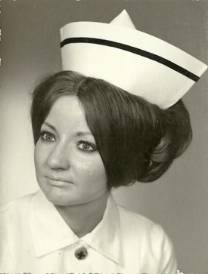
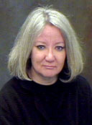
Contact Information
Arlene Kent-Wilkinson RN, CPMHN(C), BSN, MN, PhD
Professor, College of Nursing, University of Saskatchewan,
Health Sciences Building, E-Wing, Room 4242
104 Clinic Place, Saskatoon, SK, S7N 2Z4, Canada
(w) Phone: (306) 966-6897; Cell: (306) 292-8066
Email: arlene.kent@usask.ca
Profile: https://nursing.usask.ca/people/arlene-kent-wilkinson.php
WebEx: http://usask.webex.com//meet/arlene.kent

Slide 130
Guidelines for writing scholarly papers (3)
Moser, J. (2012). Guidelines for writing scholarly papers. Department of History and Political
Science, Ashland University. http://personal.ashland.edu/~jmoser1/papers.html
Things to Avoid:
Contractions:
Words like “didn’t,” “couldn’t,” and “wouldn’t”
Passive Voice:
Active Voice: “Washington chopped down the cherry tree”
Passive Voice: “The cherry tree was chopped down by George Washington.” [wordy & clumsy]
First or Second Person:
In scholarly writing, the author is assumed to have “distance” from his or her subject. You should therefore write as an outside observer, not a participant, and you should treat the reader in the same way. This means that pronouns such as “I,” “we,” or “you” are inappropriate.
Incomplete Sentences:
Every sentence must have a subject and a verb, unless it is part of a direct quote. There are no other exceptions to this rule.

Slide 131
Guidelines for writing scholarly papers (4)
Moser, J. (2012). Guidelines for writing scholarly papers. Department of History and Political
Science, Ashland University. http://personal.ashland.edu/~jmoser1/papers.html
Things to Avoid: (cont.)
Imprecise Language:
Avoid words like “good” She was a “good” leader.
Better to say: She was a “strong” leader; she was an “effective” leader
Slang:
“bumped off” – to describe a “killing”
“Bees knees”
Words Out of Proper Proximity:
“Witnesses described the thief as a six-foot-tall man with a mustache weighing 190 pounds.”
Excessive Wordiness:
do not write “time period,” when either “time” or “period” will suffice.
do not write “due to the fact that,” when a simple “because” will do.

Slide 132
Guidelines for writing scholarly papers (5)
Moser, J. (2012). Guidelines for writing scholarly papers. Department of History and Political
Science, Ashland University. http://personal.ashland.edu/~jmoser1/papers.html
Excessive Quotations: Things to Avoid: (cont.)
Often writers who have yet to develop their own “voice” have a tendency to use a lot of direct quotes from other authors.
Dumb Mistakes
confusing “its” with “it’s,” “there” with “they’re” or “their,” and “who’s” with “whose.”
subjects must agree in number with verbs, and pronouns with their antecedents;
Example: ” “Each of them had their own ideas” is wrong.
“Each of them had his [or her] own ideas” is correct.
Plagiarism
Avoiding plagiarism means citing every single source that you used in writing a paper—and “use” means draw any sort of fact (except those which are common knowledge) or interpretation.

Slide 133
Guidelines for writing scholarly papers
Moser, J. (2012). Guidelines for writing scholarly papers. Department of History and Political
Science, Ashland University. http://personal.ashland.edu/~jmoser1/papers.html
Things to Do:
Use Proper Style for Notes and Bibliographies
Pay Attention to Tense
Use Page Numbers
Proofread

Slide 134
References – Scholarly Writing
American Psychological Association. (2010). Publication manual of the American Psychological
Association (6th ed.).
American Psychological Association. (2020). Publication manual of the American Psychological
Association (7th ed.).
Dusick, D. M. (2011). The art and science of scholarly writing. Walden University.
http://www. bold-ed.com/art.pdf
Lambert, V.A., Lambert, C. E., & Tsukahara, M. (2003). Basic tips about writing a scholarly
manuscript. Nursing & Health Sciences, 5(1) 1–2.
http://dx.doi.org/10.1046/j.1442-2018.2003.00137.x.
Levasseur, R. E. (2009). Scholarly writing. Mindfire Press.
http://www.mindfirepress.com/Scholarly_Writing.html
Moser, J. (2012). Guidelines for writing scholarly papers. Department of History and Political
Science, Ashland University. http://personal.ashland.edu/~jmoser1/papers.html

Slide 135

Thank-you
Any Questions?

