Slide 1
1968 Diploma Class
50-Year Reunion June 22nd, 2018

Slide 2
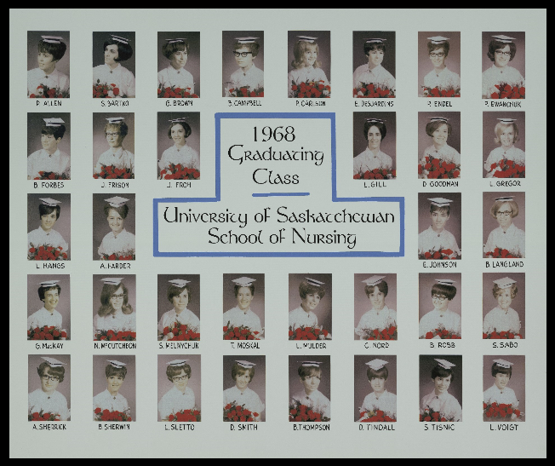

Slide 3
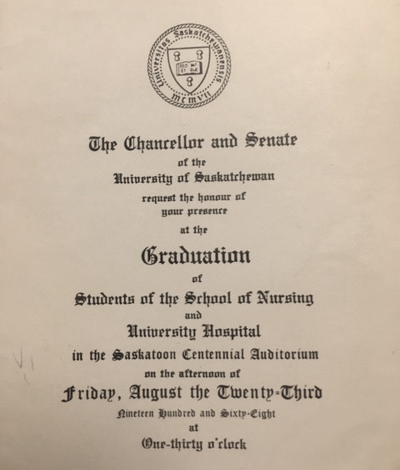
Invitation to Graduation

Slide 4
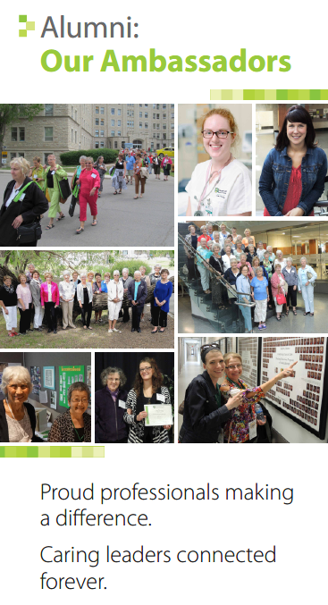

Slide 5
Ann (Sherrick) Barnsley

Slide 6
Richard & Ann Barnsley on the slopes!

Slide 7
Ann Barnsley

Slide 8
Adam Erickson, Carol (Barnsley) Erickson, Rachel Andres, Kate Andres, Judith (Barnsley) Andres, Melvin Andres, Ann (Sherrick) Barnsley & Richard Barnsley

Slide 9
Golf Katepwa! Ann Barnsley and friend

Slide 10
Patricia Carlson
In memory

Slide 11
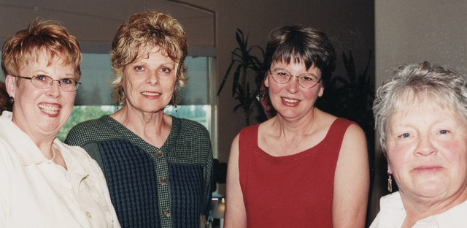
Caroll, Lynne, Linda, Trish (June 2003)

Slide 12
Lorraine Cowan

Slide 13
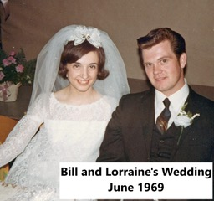
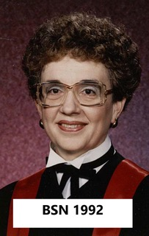

Slide 14
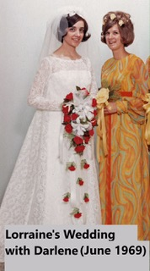
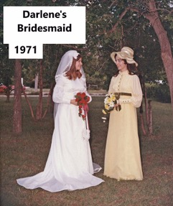

Slide 15
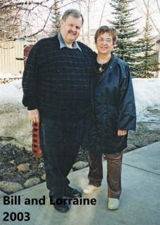
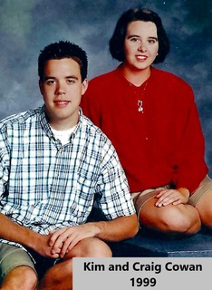

Slide 16
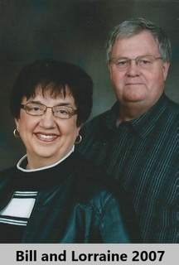
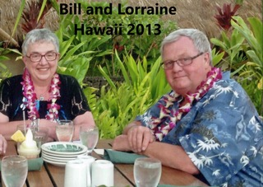

Slide 17
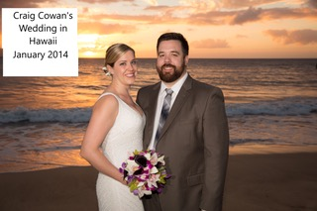
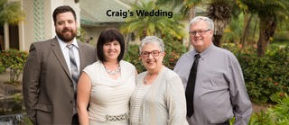

Slide 18
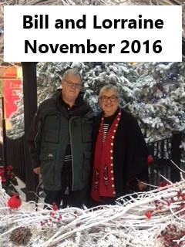

Slide 19
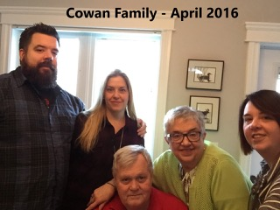
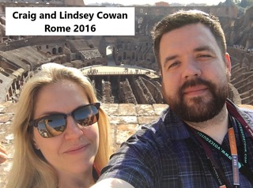

Slide 20
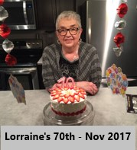
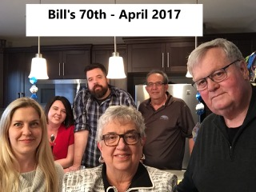

Slide 21
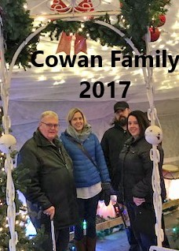
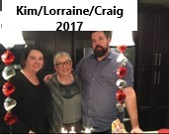

Slide 22
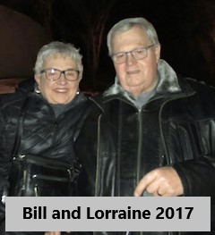
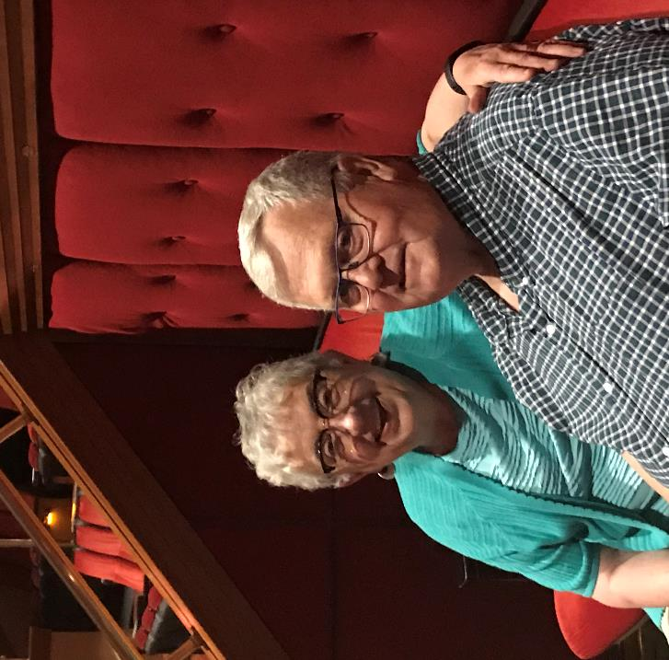
Lorraine and Bill in Vegas – May 29, 2018

Slide 23
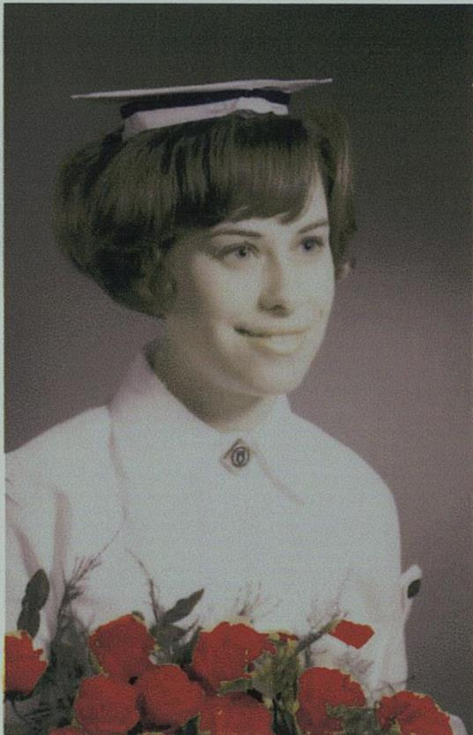
Gloria (Saunders) DeBarros

Slide 24
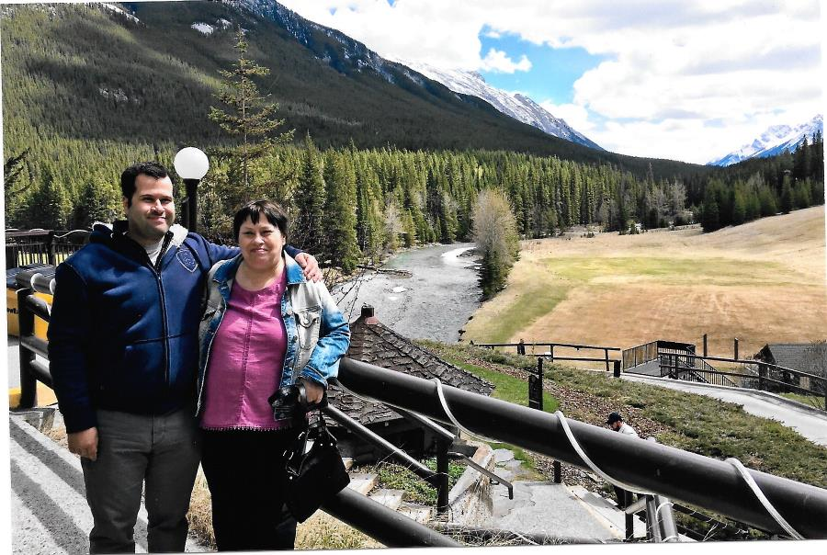
Gloria and her son Jordan

Slide 25
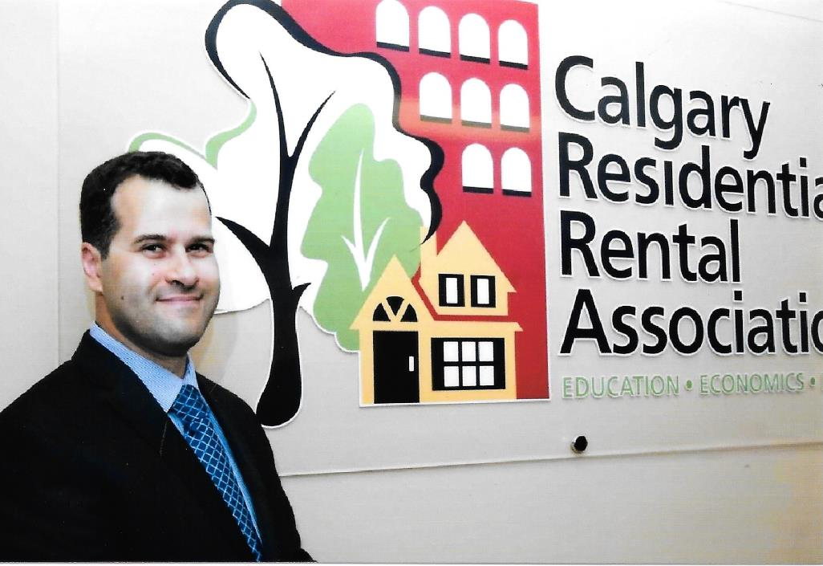
Gloria’s son Jordan

Slide 26
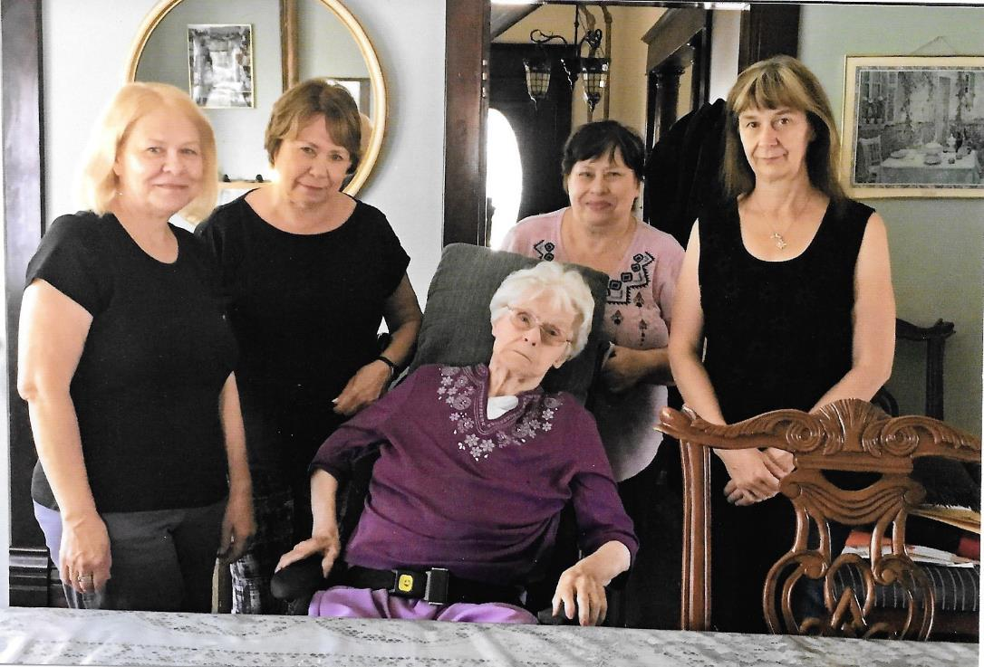
Gloria with her mom and 3 sisters

Slide 27
Eleanor (Gates) Desjardins

Slide 28
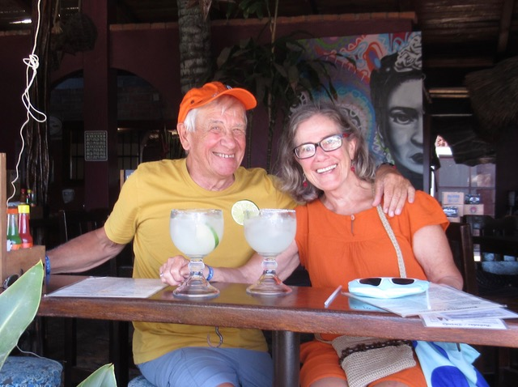
In Mexico with my friend Will Loewen (Nov 2018)

Slide 29
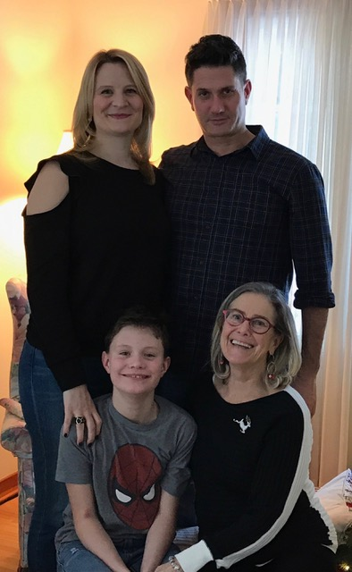
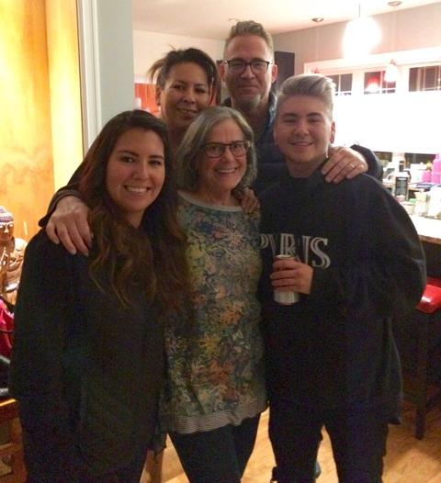
Trevor Gates (son), Sonia Eggerman,
Atticus Eggerman Gates, Eleanor (2018)
My Step-son Chad Duncan, Christina Duncan, Kim & Jessie Duncan (2018)

Slide 30
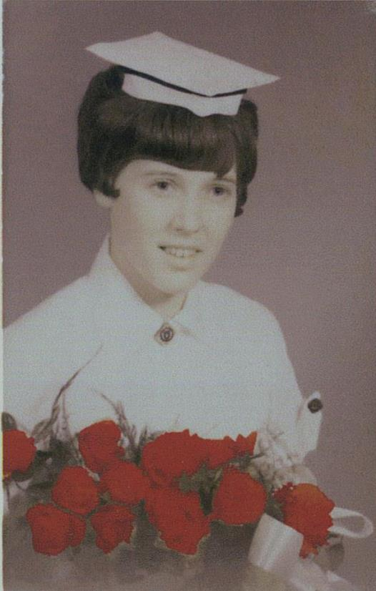
Evelyn (Voigt) Finlayson

Slide 31
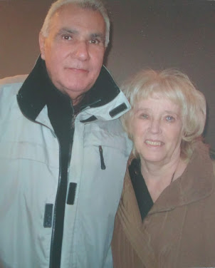
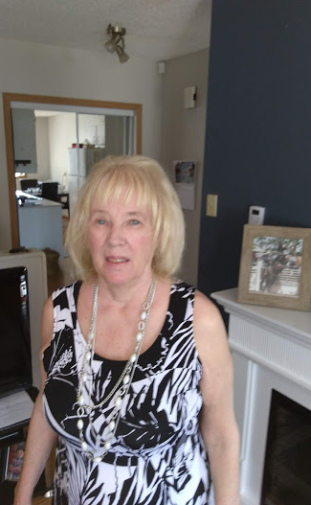
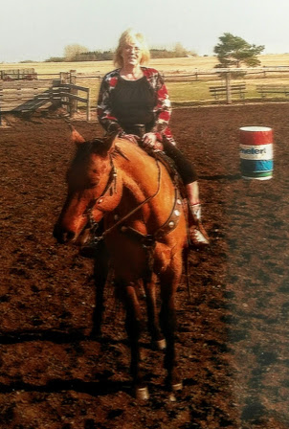
Michael Allen & Lynne (2014)
Lynne (2016)
Lynne doing what she likes best! (2014)

Slide 32
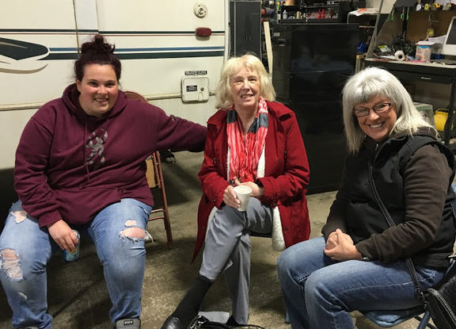
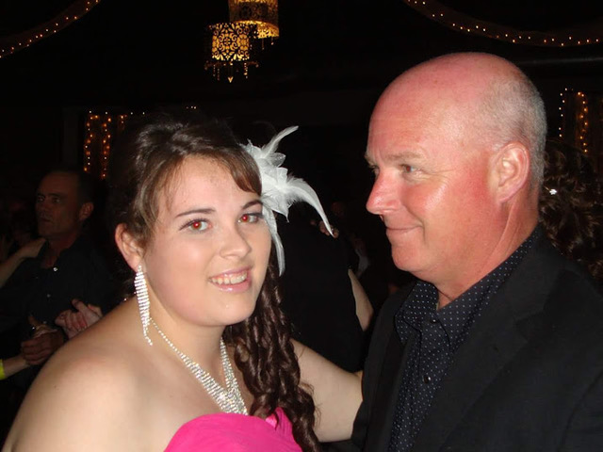
Meg, Lynne & daughter Evelyn
Meg & Rob Farrow (Evelyn's daughter & husband)
2016

Slide 33
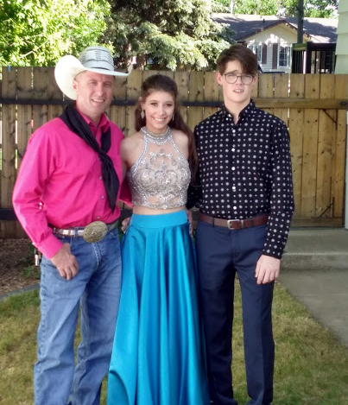
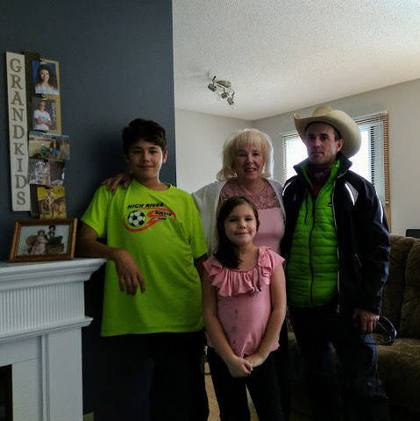
Son Rory with children Brodie-Lyn & Houston
Lynne, Cole (son) with children Josh & Angela
2017

Slide 34
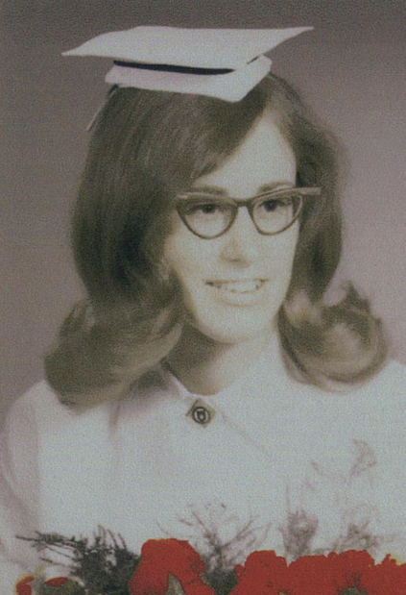
Nancy (McCutcheon) Fraser

Slide 35
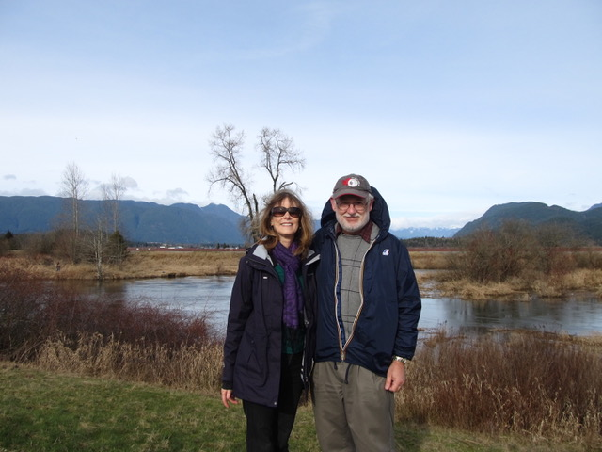
Nancy and Wally (husband) – 2017

Slide 36
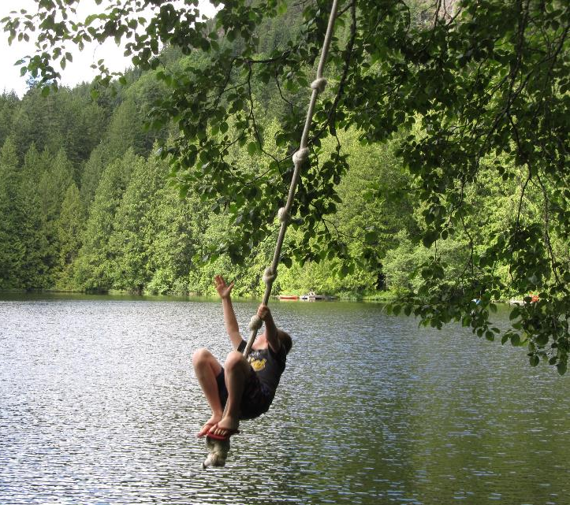
Nancy’s son, Graham, and his wife, Shannon at the cabin
Nancy’s grandson, Rowan,
having fun on rope swing at lake

Slide 37
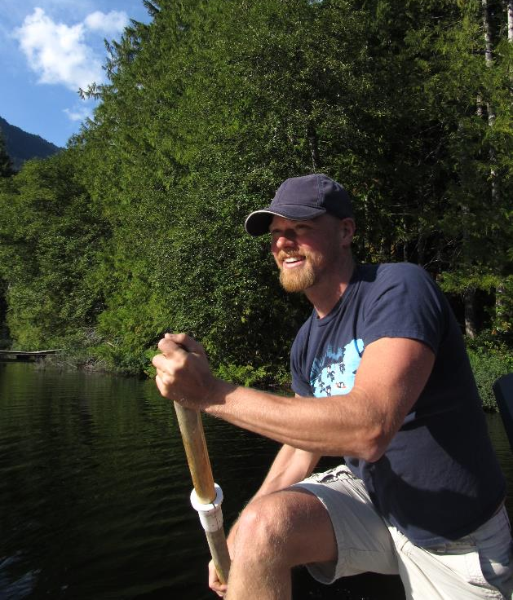
Winter with Nancy’s grandchildren, Rowan and Kiera
Nancy’s son, Trevor, helping paddle their dock to the lake Dock Party

Slide 38
Nancy and her son, Trevor, after he finished running the Mountain Madness Race

Slide 39
Shirley (Bartko) Gilbertson

Slide 40
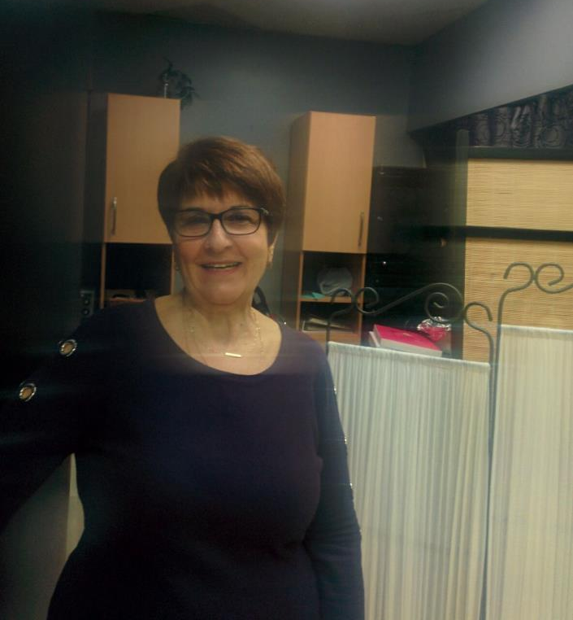
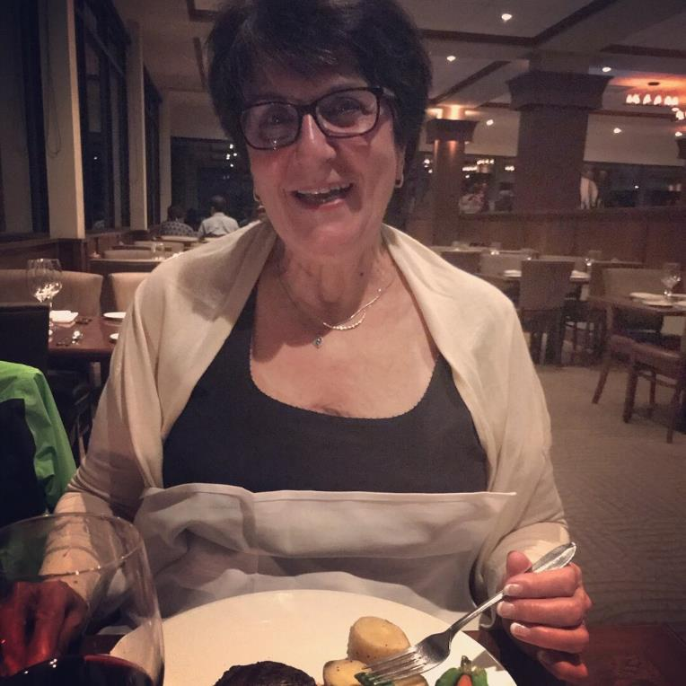
Shirley’s 70th Birthday Celebration (Oct 29/17)

Slide 41
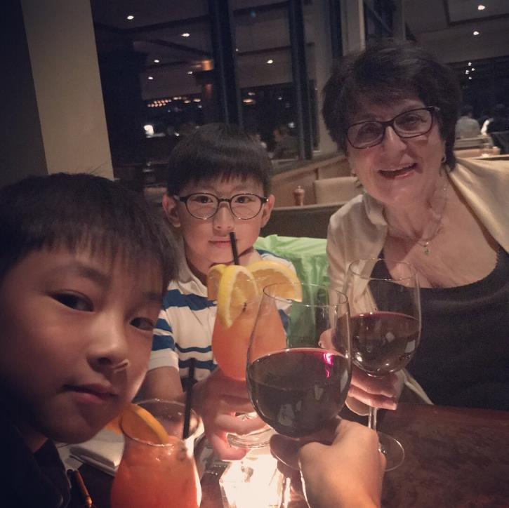
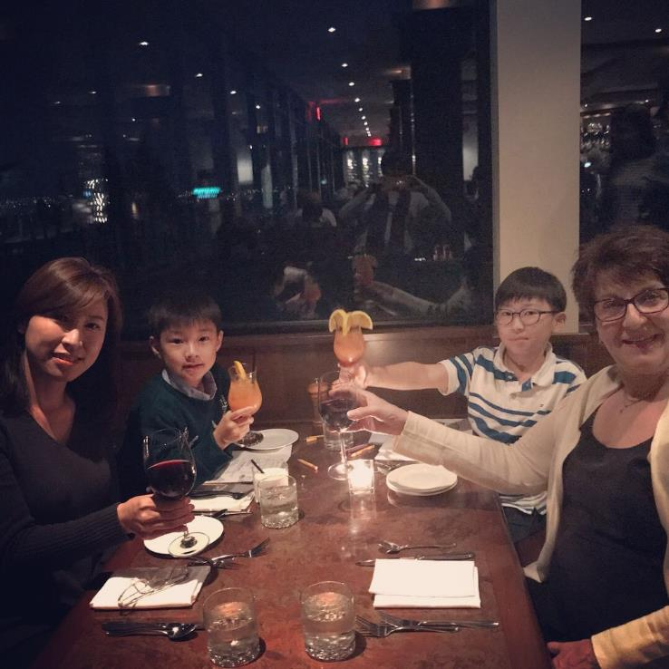
Shirley’s 70th Birthday Celebration (Oct 29/17)

Slide 42
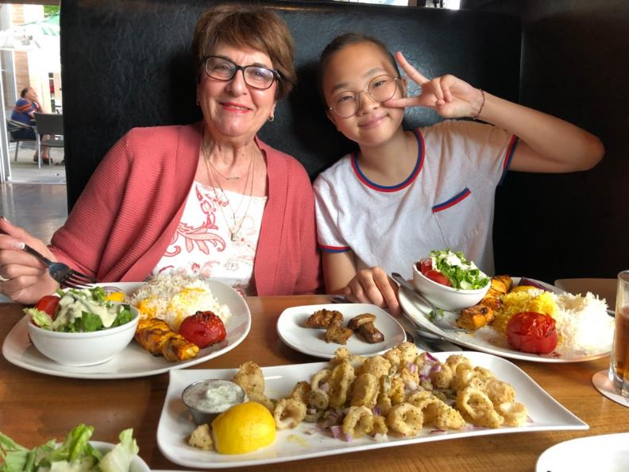
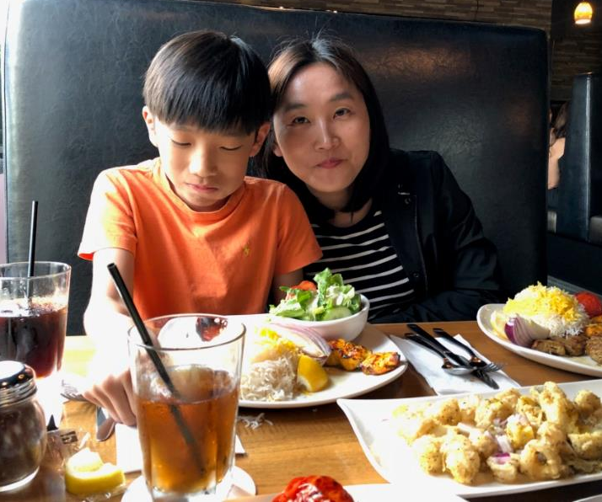
Shirley’s 70th Birthday Celebration with Korean friend April Cho & family (Oct 29/17)

Slide 43
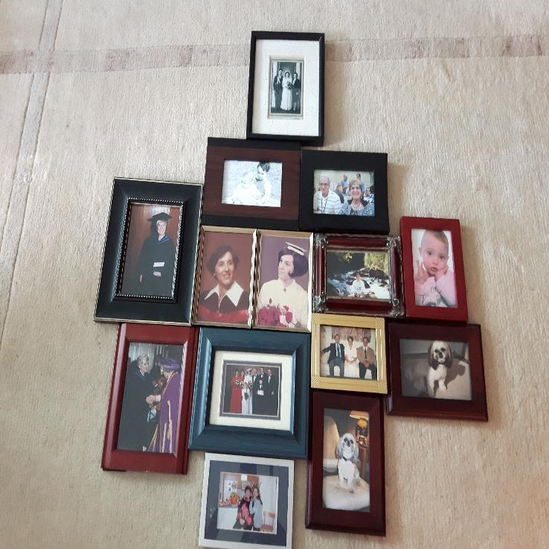
Shirley’s Picture Wall of Memories (2018)

Slide 44
Edith (Johnson) May

Slide 45
Edie and Aron (2017)

Slide 46
Darren (son) and Teresa (his wife) – 2017

Slide 47
Trinity (15 yr.) & Terra (17 yr.) Darcia’s Daughters; Darcia (Daughter) & Wayne (Husband)

Slide 48
Aron’s daughter, Susan, with husband, Jay, and Daughter, Marlow (8 yr.)

Slide 49
Pat (Ewanchuk) Halko

Slide 50
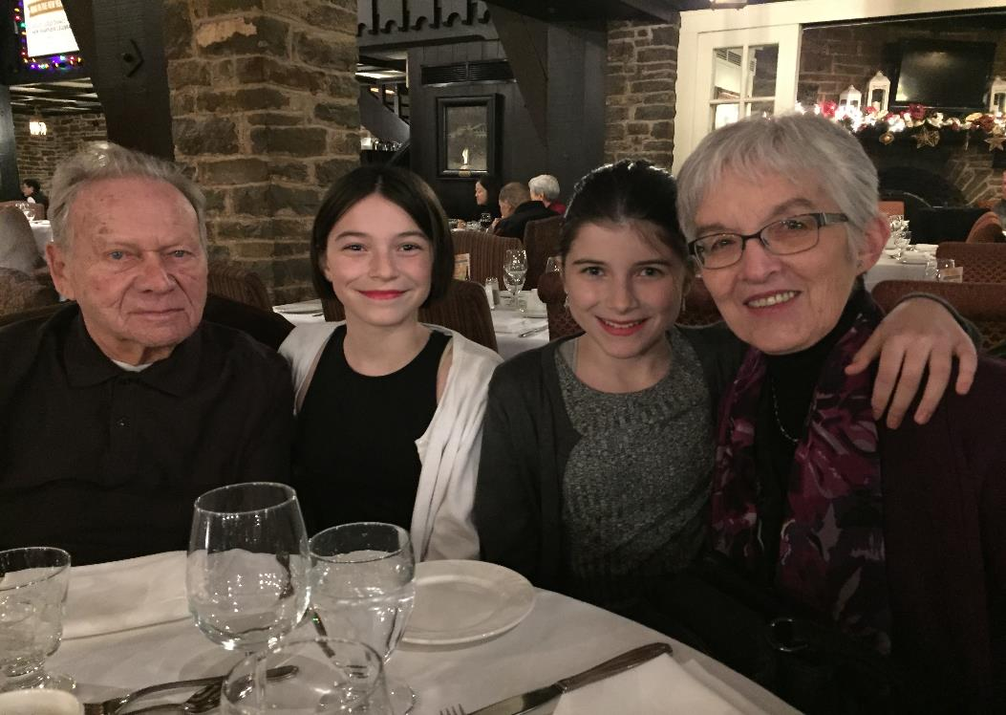
Pat’s granddaughters Sophia & Rachael (Dec/17)

Slide 51
Roman, Alison, Melanie, Kristen, Jayden, Jacob (2018)
Justin 17, Sherene & Steven (2nd son), Devin 19 (2018)

Slide 52
Sophia 13, Rachel 11 & Roxanne (daughter holding cousin) – 2018

Slide 53
Darlene (Tindall) Heald

Slide 54
Darlene (Tindall) Heald

Slide 55
Darlene & Gavin Heald

Slide 56
Darlene’s daughter, Kiri & her husband, Simon; Children Kaian & Siana – Cambodia 2018

Slide 57
Grandpa Gavin and Kaian & Siana (Darlene’s dog, Koko) – 2017

Slide 58
Kiri Heald with Simon, Kaian & Siana in Phnom, Penh. (Easter 2018)

Slide 59
Their Canadian Heritage – Louis Tindall Homestead – June 2017

Slide 60
One last ride on King. (Sept 2017)

Slide 61
Tala Heald in the Hat. (April 2018)

Slide 62
Tala Heald & Scott Williams in Paris (2017)
Tala Heald and Scott Williams in Iceland (2016)

Slide 63
Thelma (Moskal) Inkson

Slide 64
Alan & Thelma with grandkids Pascal, Cooper, Marc Andre, Carter, Lynden, Story (Dec 24, 2016)

Slide 65
Alan Lister & Thelma Algarve, Portugal (2017)
Thelma & Alan Confederation Trail, PEI (2018)

Slide 66
Christmas (2017)
Lynden, Troy, Diana, Story Moskal
Christmas (2018)
Pascal, Pierre, Tanya (M), Marc-Andre Hebert

Slide 67
Christmas (2018)
Cooper, Lianne (L), Larry, Carter Frank

Slide 68
Linda (Sletto) Jarock

Slide 69
Linda Jarock and husband Bob

Slide 70
Judy (Froh) Keyser

Slide 72
Judy Keyser’s Family

Slide 73
Judy Keyser’s Family

Slide 74
Bonnie (Jolly) Langland

Slide 75
Bonnie Langland (May 20, 2018)
Chris, Bonnie, Janelle, Sarah & Grant (Sarah's partner) – Dec 25/18

Slide 76
Gwen MacKay

Slide 77
Linda (Gregor) McCann

Slide 78
Linda & Tara (daughter) in India (Dec 2018)
Grandchildren: Brandon 22y, Mischa 9y, Kinsley 7y (Dec 25/18)
Barrett (son) & Krista with daughters Kinsley & Mischa (Dec 25/18)

Slide 79
Cristin (daughter) & her son Brandon with Kinsley & Mischa (Dec 25/18)

Slide 80
Safari (Dec 12/18)
Zodiac (Dec 12/18)
Marley & Indigo (white) (Dec 12/18)

Slide 81
Sharon (Melnychuk) Mikitzel

Slide 82
Sharon & John in Singapore with Singapore Slings! (April 2018)

Slide 83
Ashley (daughter) & Taylor’s Wedding

Slide 84
Sharon & John with Adam Jr., Lisa, Lily and Adam (Dec 2017)

Slide 85
Bev (Sherwin) Muench

Slide 86
Ron and Bev in Mexico (2014)
Ron and Bev (2018)

Slide 87
Bev & Ron’s sons Kent, Mark, Kurtis, Craig Muench (1988)
All grown up! Kurtis, Kent, Mark, Craig (2016)

Slide 88
Kent (son), Carrie, and Noah, Adlai and Kalen (2016)
2016 – Kurtis (son), Dara, and Victoria (New baby in Oct/18)

Slide 89
Mark (son), Krissy, and Ellis (2018)
Craig (son), Kristin, Everett and Avery (2018)

Slide 90
Muench Family – June 2017

Slide 91
Lynne Mulder

Slide 92
Lynne Mulder – Top Grad

Slide 93
Lynne Mulder (2017)
Lifetime Achievement Award (2018)
Cover Page (2017)

Slide 94
Lynne with Kaya as a puppy (2017)
Kaya & Lily (2018)

Slide 95
Beryl (Campbell/Zemlak) Near

Slide 96
Beryl Near & daughter, Kerri Orris Holidaying in England (2017)

Slide 97
Beryl Near’s daughter, Kerri Orris & family April 2018

Slide 98
Beryl Near’s son, Kevin Zemiak and his family in Saskatoon

Slide 99
Beryl with her son Kevin visiting granddaughter, Bailey, in Iowa – 2018

Slide 100
Beryl with Jordan & Bailey Zemlak (Summer 2017)

Slide 101
Agatha (Harder) Neufeld

Slide 102
Agatha and Jim with their grandchildren (Oct 10, 2015)

Slide 103
Charlene – oldest (2018)
Christina and family – 2nd (2015)

Slide 104
Cynthia – 3rd (2014)
David – youngest (2014)

Slide 105
Patricia (Allen) Olson

Slide 106
Blanche (Forbes) Richards

Slide 107
Blanche & Wayne (2017)
Wayne, Robyn, Mark, Sara, Blanche,
Ainsley, Sloane, Isla (2018)

Slide 108
Bev (Banks) Robb
In memory

Slide 109
Doreen Smith

Slide 110
Caroll (Nord) Spence

Slide 111
Caroll (Nord) Spence (April 2015)

Slide 112
Caroll (Nord) Spence – May 2017

Slide 113
Caroll’s 70th Birthday! (June 2017)
Clarence, Caroll, Marnee (daughter), Greg (son), Carmen (daughter) – June 2017

Slide 114
Caroll & Clarence (August 2014)
Caroll & Clarence (June 2017)

Slide 115
Caroll & Clarence with Family (2017)

Slide 116
2017 Christmas with Caroll (Nord) Spence & Family

Slide 117
FRONT LEFT: Marnee, Aiden, Kingsley CENTER: Clarence, Caroll, Greg, Michelle, Carm BACK: Tianna, Cacia, Abi, Belle, Eric, Trevor (MISSING: Taylor)
April 2018 in Canmore

Slide 118
Sharron (Sabo) Stone

Slide 119
Sharron with husband Ivan (Sept 3/17)

Slide 120
Sharron with husband Ivan & family in Italy (Sept 3/17)

Slide 121
Donna (Goodman) Van Vliet

Slide 122
Donna & Jon
Vliet
Surprise, AZ 2018

Slide 123
Donna with Chelsea & Meghan
Surprise, AZ 2018

Slide 124
Chelsea & Meghan (1987)

Slide 125
Donna, Jon and grandkids: Elodie, Bowen, Ella & Jon
Grandkids: Leila, Jon and grandkids: Elodie, Bowen, Ella & Jon

Slide 126
Michael & Leila (19 months)

Slide 127
Michael gets his MD
Michael, Jasmine & Leila (wedding) – Jan/17

Slide 128
Meghan (wedding) – 2013
Leila with Grandma & Grandpa – Christmas 2016

Slide 129
Van Vliet Family – Summer 2017

Slide 130
Donna:
30-Year Teaching Pin – Selkirk College
3rd Place in 70 and Over – 5 km Race

Slide 131
Donna
Nisod Medal
For Teaching Excellence
2000

Slide 132
“Poster Girl” for new nursing lab – Selkirk 2005

Slide 133
Clinical Supervision – Selkirk College

Slide 134
Donna & Jon – Mexico 2005 – “Aren’t we cool!”

Slide 135
Donna, Bev & Ron – Australia’s Great Barrier Reef 2010

Slide 136
Barb (Thompson) Vaughn
In memory

Slide 137
Bill Cowan, Brian & Barbara Vaughn, Shirley Tisnic (1969)

Slide 138
Shirley (Tisnic) Walker

Slide 139
Shirley & Bud (2010)
Shirley & Bud (2018)

Slide 140
Shirley & Rocky (2014)
Olga T (93y), Ena (Sean's partner), Shirley, Sean (son), Bud (2018)

Slide 141
Pat (Endel) Wirth

Slide 142
Pat & Terry (Dec 3, 2018)

