Slide 1
First Day in uniform (Fall 1965)

Slide 2
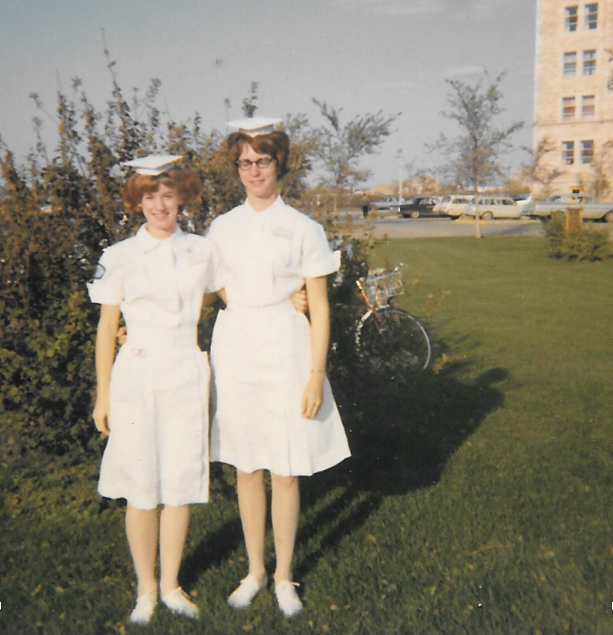
Darlene and Bev - First day in uniforms

Slide 3
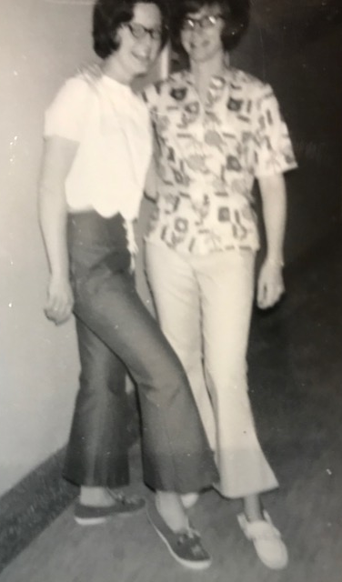
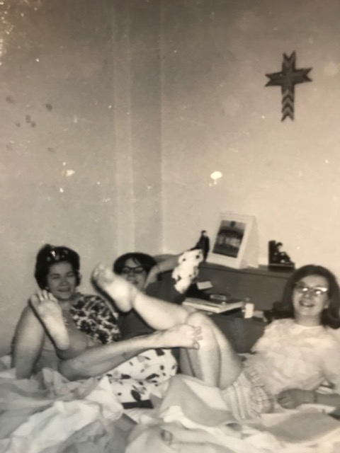
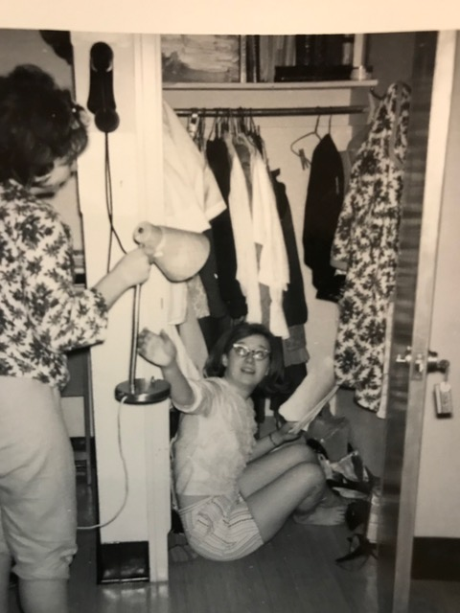
Blanche and Bev checking out the style!
Fun times in residence! Joanna Moncrief, Bev and Donna
Residence life! Best place to study for Donna!

Slide 4
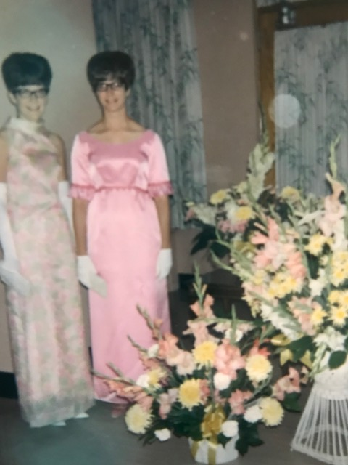
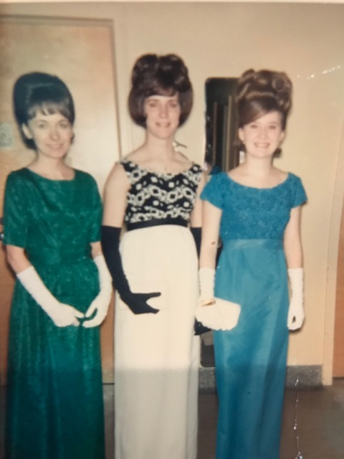
Blanche and Bev ready to go to a formal!
Belles at the Bess - WOW!
Barb Thompson, Bev, Donna

Slide 5
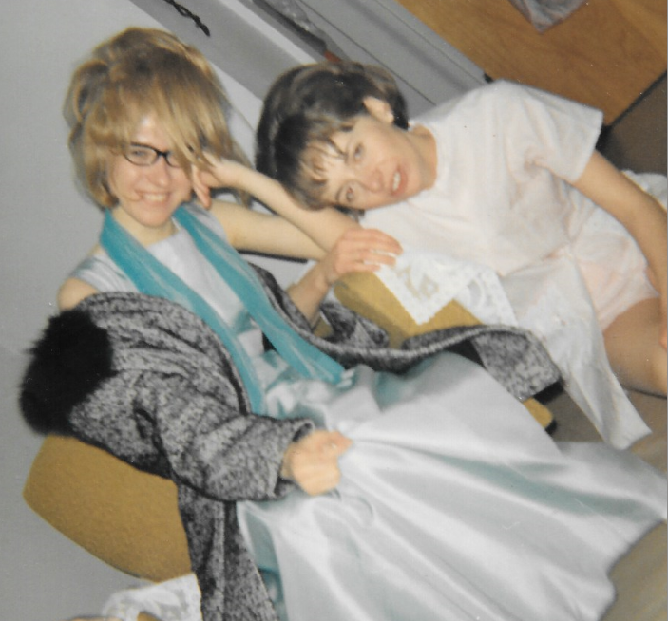
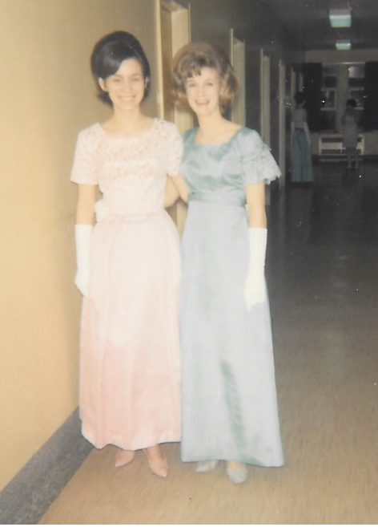
Bonnie & Barbara (1966)
Shirley & Darlene (1966)

Slide 6
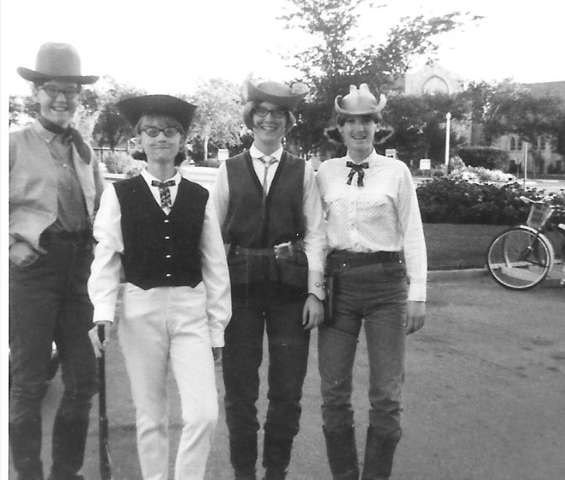
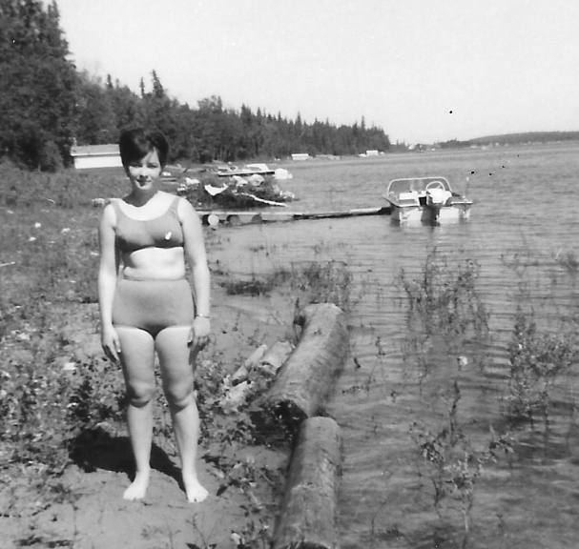
Joanna Moncrief (1966)
Blanche, Bonnie, Donna & Darlene (1966)

Slide 7
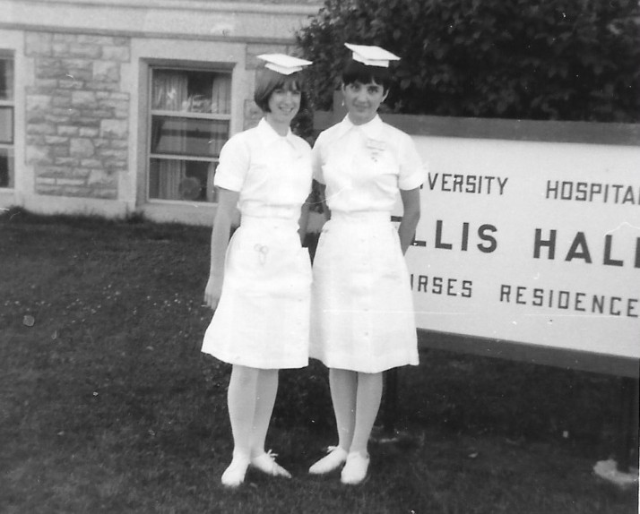
Darlene, Lorraine - bands and senior pins (1967)

Slide 8
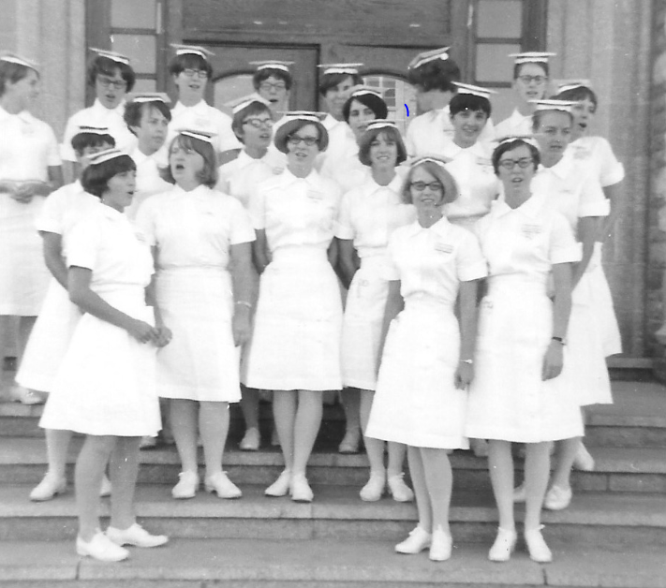
1967

Slide 9
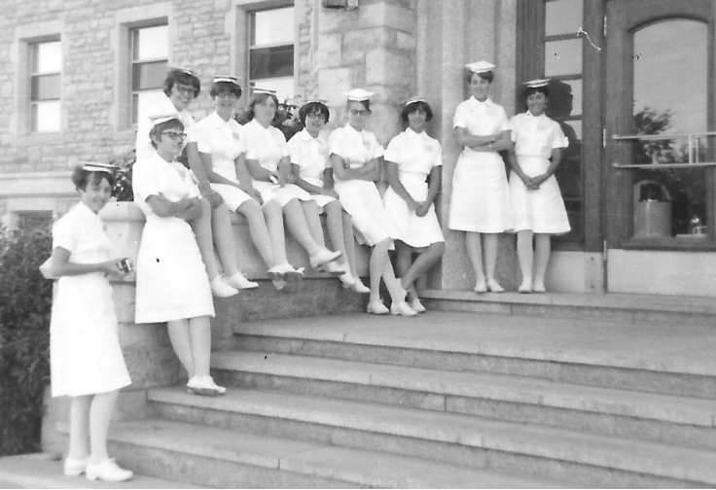
1967

Slide 10
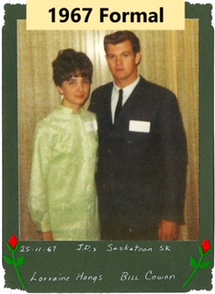
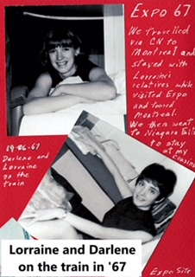
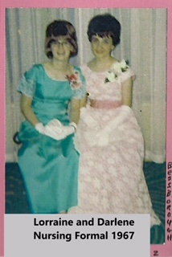

Slide 11
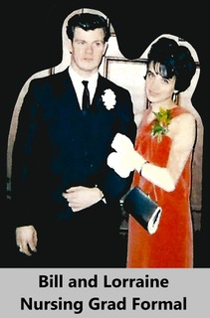
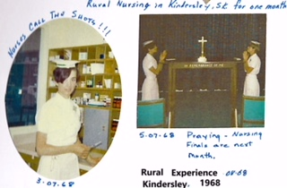

Slide 12
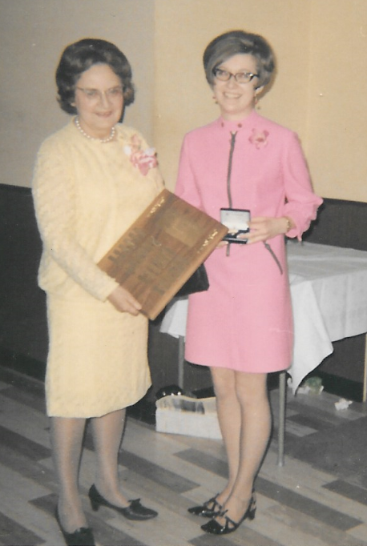
Hazel Keeler & Donna (1968)

Slide 13
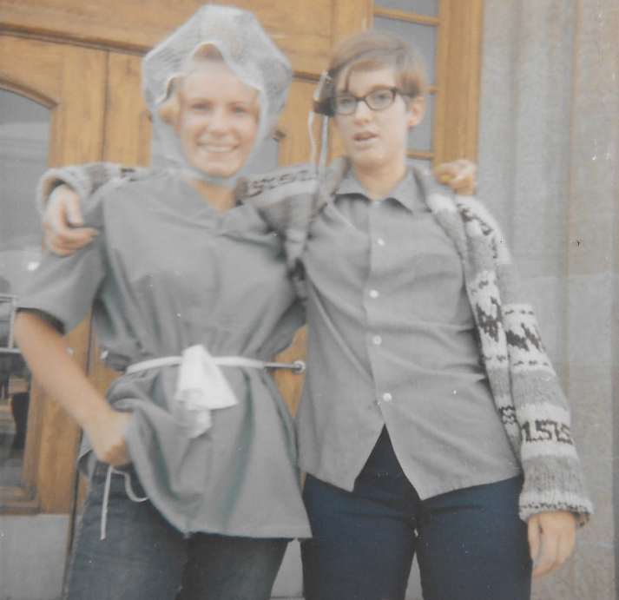
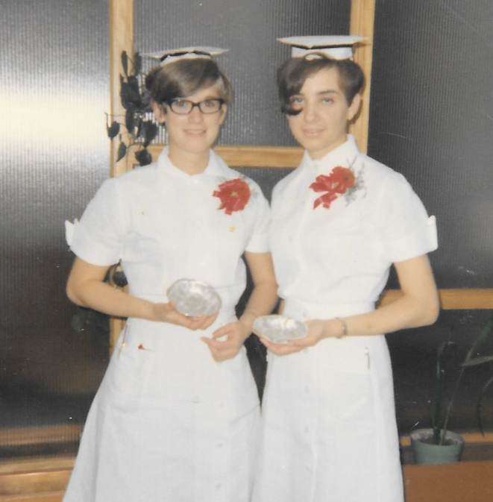
Linda & Darlene – Finished RN Exams! (1968)
Darlene & Lorraine - Finishing Day (1968)

Slide 14
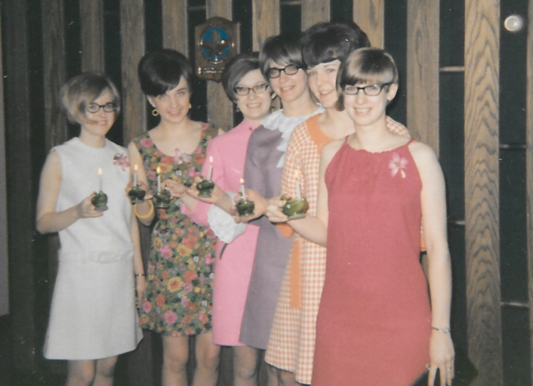
Bonnie, Lorraine, Donna, Bev, Blanche & Donna (1968)

Slide 15
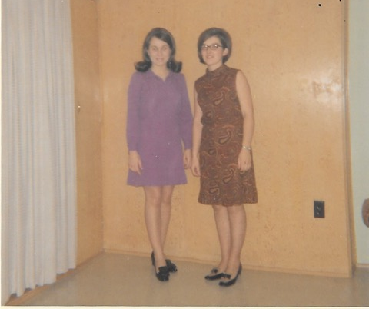
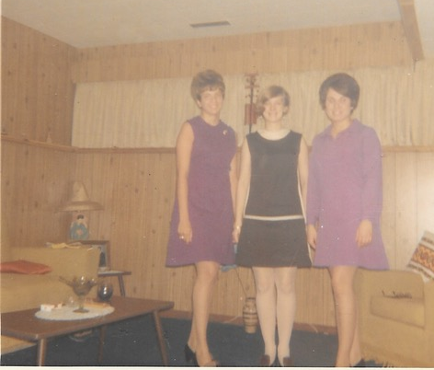
Sharon, Pat, Darlene, Doreen – Roommates in Vernon BC (Nov 24, 1968)

Slide 16
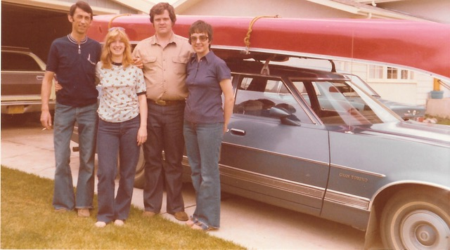
Camp/Canoe Friends – Gavin, Darlene, Bill, Lorraine (June 1975)

Slide 17
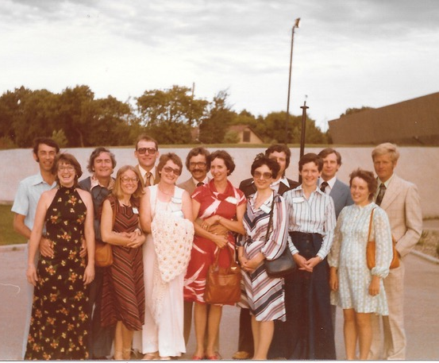
9-Year Reunion (June 25, 1977) Darlene, Bonnie, Ann, Bev, Lorraine, Blanche, Pat with husbands.

Slide 18
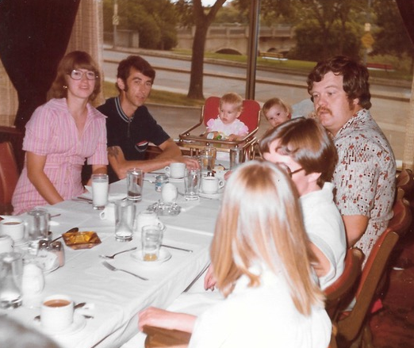
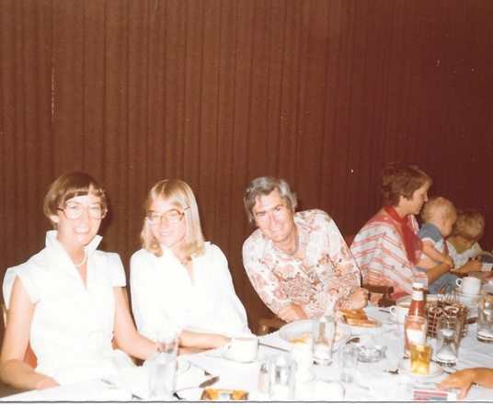
9-Year Reunion (June 26, 1977) Pat, Bonnie, Chris, Pat at breakfast
9-Year Reunion (June 26, 1977) Darlene, Gavin, Kiri, Kim, Bill, Pat

Slide 19
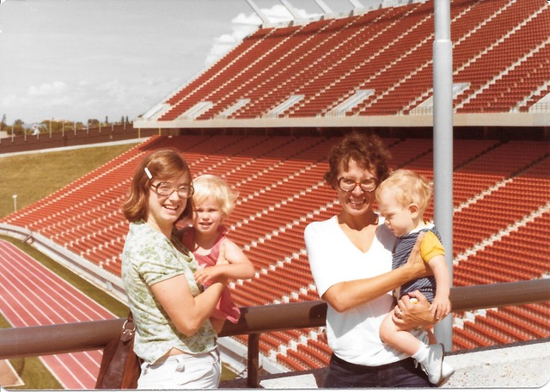
Friends get together – Darlene, Kiri, Sharon M, Adam – June 1978

Slide 20
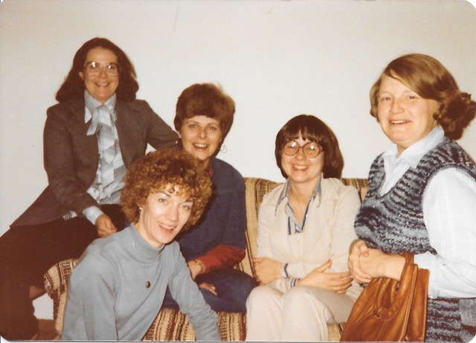
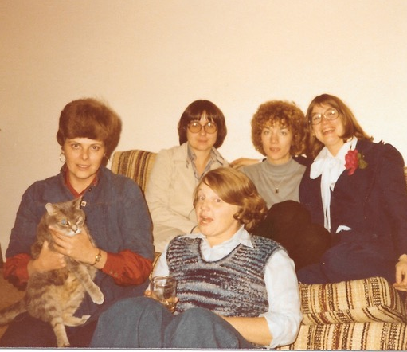
Friends get together (Nov 1978) Eleanor, Lynne, Edith, Bev R, Trish
Friends get together (Nov 1978) Lynne, Bev R, Trish, Edith, Darlene

Slide 21
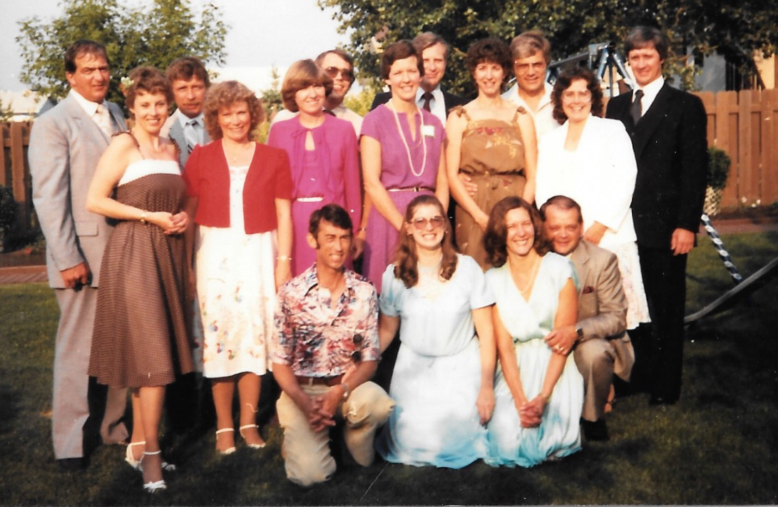
14-Year Reunion – Caroll, Linda, Donna, Blanche, Bev, Eleanor, Darlene, Thelma (1982)

Slide 22
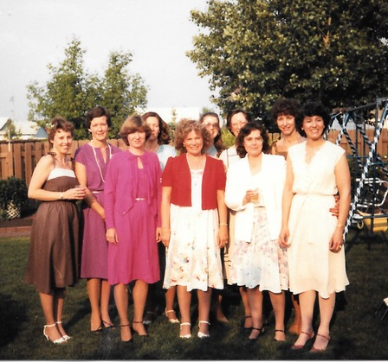
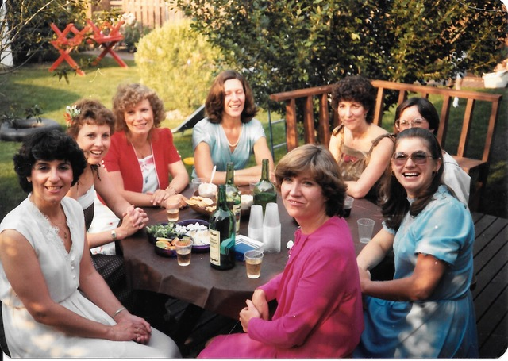
14-Year Reunion (June 26, 1982) Shirley, Caroll, Linda, Thelma, Bev, Pat, Darlene, Donna
14-Year Reunion (June 26, 1982) Caroll, Blanche, Donna, Thelma, Linda, Darlene, Pat, Eleanor, Bev, Shirley

Slide 23
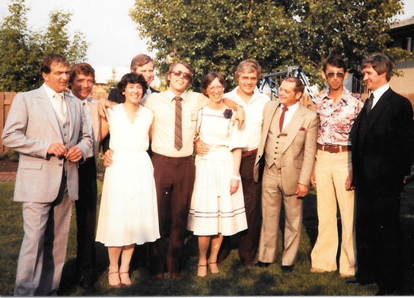
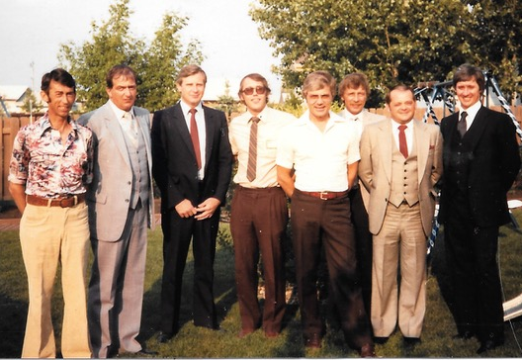
14-Year Reunion (June 26, 1982) Shirley, Jon, Pat
14-Year Reunion (June 26, 1982) Gavin, Al, Wayne, Jon, Ron, Rick, Danny, Ronnie

Slide 24
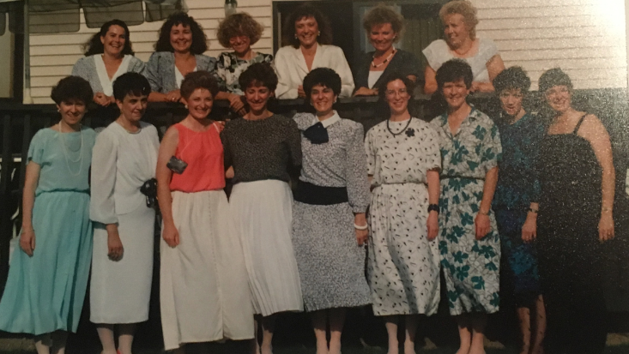
20-Year Reunion – Eleanor, Bev, Bonnie, Judy, Linda, Pat, Donna, Lorraine, Ann, Bev, Shirley, Pat, Blanche, Edith, Darlene (1988)

Slide 25
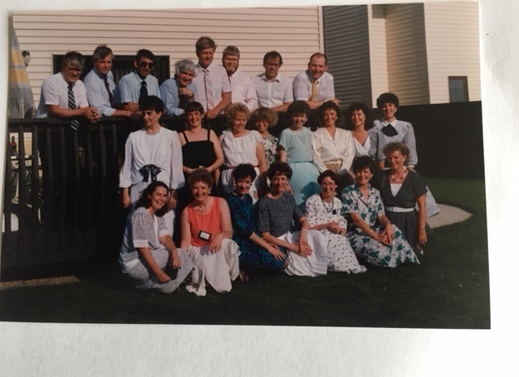
20-Year Reunion – Lorraine, Darlene, Pat, Bonnie, Donna, Judy, Bev, Shirley, Eleanor, Ann, Edith, Bev, Pat, Blanche, Linda (1988)

Slide 26
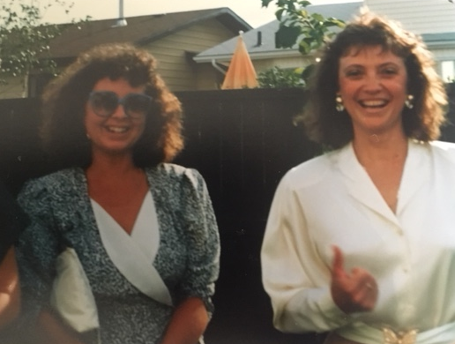
20-Year Reunion (Bev & Judy) – 1988
Bev & Judy

Slide 27
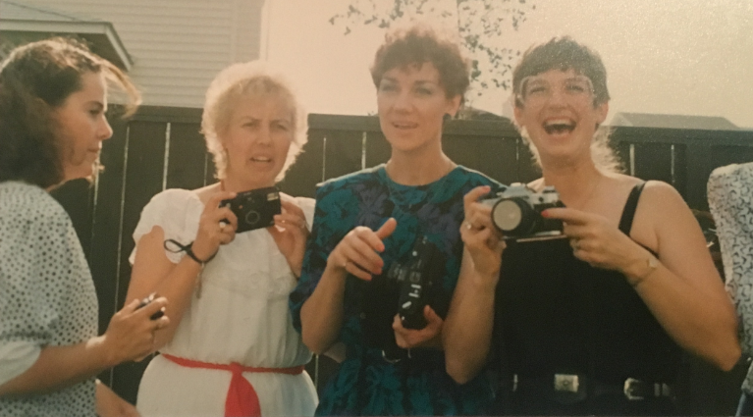
20-Year Reunion – Eleanor, Pat, Edith, Darlene (1988)

Slide 28
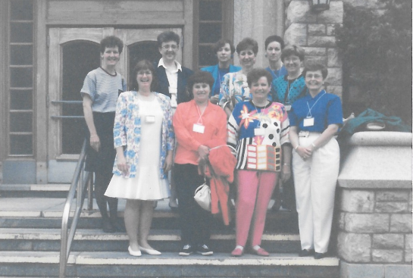
25-Year Reunion Blanche, Darlene, Lorraine, Gloria, Shirley, Bev, Linda, Edith, Donna, Beryl (1993)

Slide 29
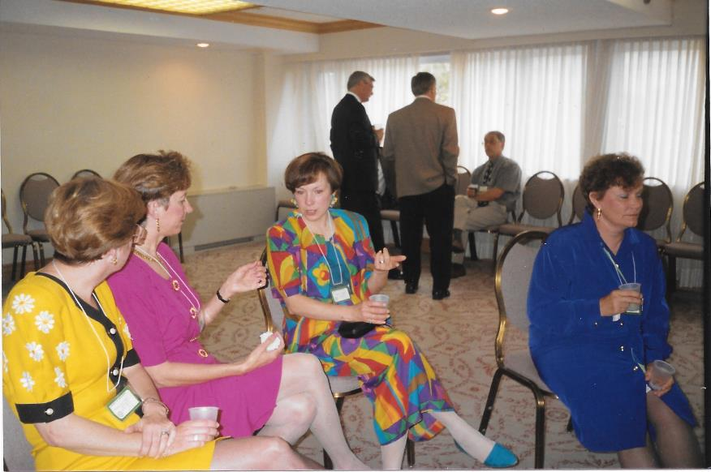
Donna, Bev, Ann
Donna, Bev, Shirley T., Linda
25-Year Reunion - 1993

Slide 30
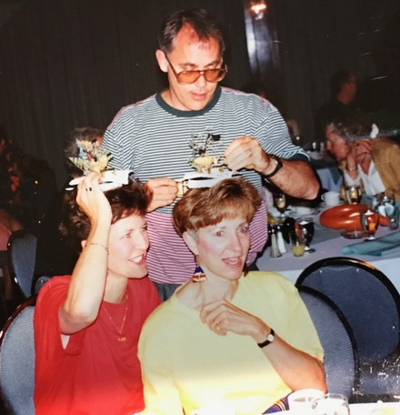
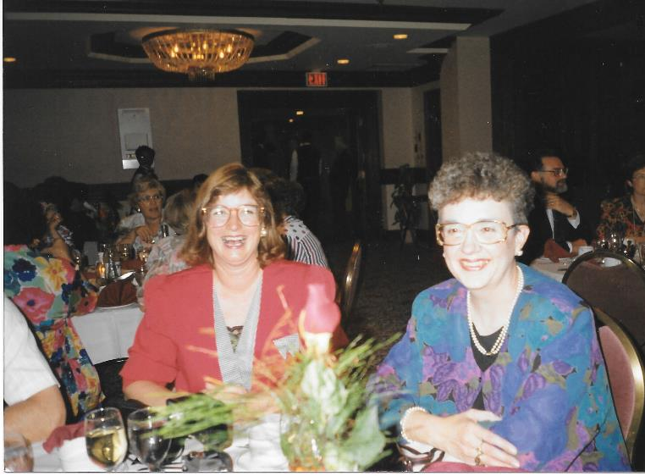
25-Year Reunion (1993)
Darlene & Lorraine
25-Year Reunion (1993)
Blanche, Bev, Jon

Slide 31
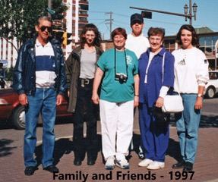
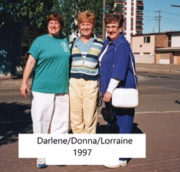

Slide 32
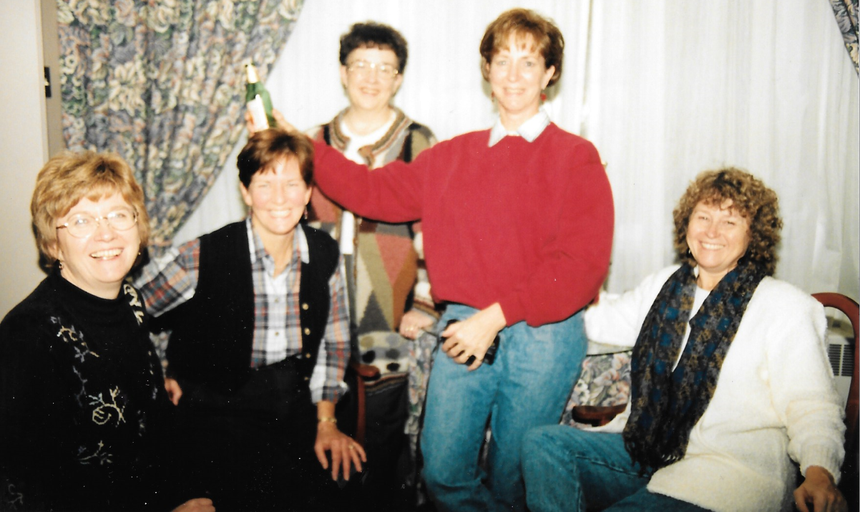
Shopping trip to Edmonton – Donna, Blanche, Lorraine, Bev, Bonnie (1997)

Slide 33
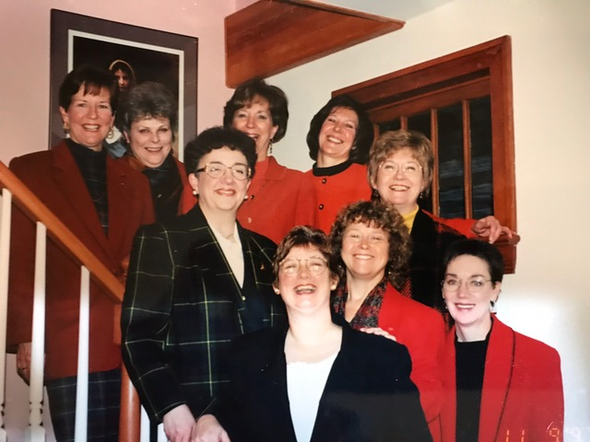
Mini 29-Year Reunion (Nov 8, 1997) Blanche, Lynn, Bev, Thelma, Donna, Lorraine, Darlene, Bonnie, Edith

Slide 34
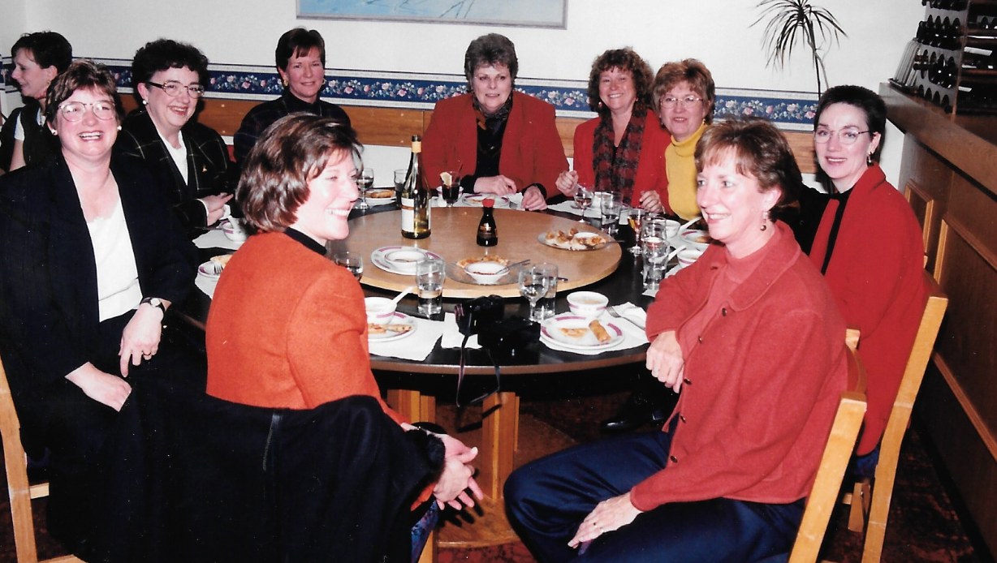
Mini 29-Year Reunion (1997) Thelma, Darlene, Lorraine, Blanche, Lynne, Bonnie, Donna, Edith, Bev

Slide 35
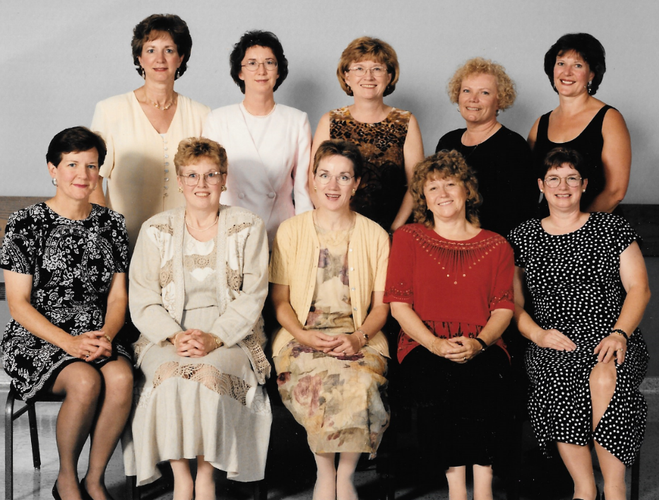
30-Year Reunion (1998) Bev, Pat, Donna, Linda, Thelma, Blanche, Caroll, Edith, Bonnie, Darlene

Slide 36
30-Year Reunion (June 27, 1998) Donna, Pat, Linda, Bonnie, Lorraine, Ann, Edith, Darlene, Bev, Thelma

Slide 37
A visit to Edmonton! (2001) Thelma, Darlene, Pat

Slide 38
35-Year Reunion (2003) Bonnie, Blanche, Pat, Darlene, Bev, Donna

Slide 39
35-Year Reunion (June 2003) Blanche, Ann, Pat, Pat, Beryl, Sharron, Darlene, Linda, Bev, Lynne, Caroll, Donna, Nancy, Linda, Trish

Slide 40
35-Year Reunion (June 20, 2003) Caroll, Ann, Nancy, Beryl, Linda, Sharron, Donna, Pat O, Darlene, Bonnie, Pat W, Lynne, Linda, Bev, Blanche, Trish

Slide 41
Yvonne Brown still teaching us at Ellis Hall (2003)

Slide 42
35-Year Reunion (2003) Trish & Lynne singing for Breakfast

Slide 43
40-Year Reunion (2008)
40-Year Reunion (2008)
The Guys: Don, Jon, Allen, Ron, Gavin, Wally

Slide 44
40-Year Reunion (June 2008) Thelma,Bonnie,Donna,Bev, Blanche
40-Year Reunion (June 2008) Yvonne Brown with her book

Slide 45
40-Year Reunion (June 2008) Darlene, Linda & Ann
40-Year Reunion (June 2008) Donna, Darlene, Bev, Bonnie, Blanche

Slide 46
40-Year Reunion (2008) Nancy & Beryl
40-Year Reunion (2008)
Beryl & Lorraine

Slide 47
40-Year Reunion (Thelma, Sharron, Linda) – 2008

Slide 48
40-Year Reunion (Ann, Darlene, Nancy, Beryl, Thelma) – 2008

Slide 49
Barry & Yvonne Brown (2008)

Slide 50
40-Year Reunion (Darlene, Blanche, Lorraine, Bonnie, Sharron, Donna, Linda, Bev) – 2008

Slide 51
40-Year Reunion (2008) Donna, Bonnie, Bev, Blanche

Slide 52
40-Year Reunion (2008)
40-Year Reunion (2008) Darlene & Lorraine

Slide 53
40-Year Reunion (2008) Donna, Nancy, Thelma, Linda, Blanche, Sharron, Lorraine, Bev, Bonnie, Darlene

Slide 54
40-Year Reunion Donna, Thelma, Linda, Sharron, Darlene, Bev, Nancy, Linda, Blanche, Lorraine (2008)

Slide 55
Darlene, Gavin, Lorraine, Bill in Florida (Feb 2012)

Slide 56
45-Year Reunion (2013) Nancy, Eleanor, Beryl, Pat

Slide 57
45-Year Reunion – Now Listen Up! (2013)

Slide 58
45-Year Reunion (2013) Pat, Lynne, Darlene

Slide 59
45-Year Reunion (2013) Pat, Trish, Thelma, Linda, Donna

Slide 60
45-Year Reunion (2013) Alan & Thelma
45-Year Reunion (2013) Bev & Blanche

Slide 61
45-Year Reunion (Eleanor, Bev, Pat, Donna, Darlene, Blanche, Bonnie) – 2013

Slide 62
45-Year Reunion (2013)

Slide 63
Old residence room (2013)
Good old Ellis Hall (2013 )

Slide 64
Models (2013 )

Slide 65
River Cruise (2013)
The Berry Barn (2013)

Slide 66
45-Year Reunion (June 7-8, 2013) Edith & Lynne
45-Year Reunion (June 7-8, 2013) Ann & Beryl

Slide 67
45-Year Reunion (June 7-8, 2013) Bonnie, Blanche, Shirley
45-Year Reunion (June 7-8, 2013) Linda, Caroll, Nancy

Slide 68
45-Year Reunion (June 7-8, 2013) Beryl, Shirley, Eleanor
45-Year Reunion (June 7-8, 2013) Nancy, Caroll, Donna, Beryl

Slide 69
45-Year Reunion (June 7-8, 2013) Trish & Darlene
45-Year Reunion (June 7-8, 2013) Lynne & Nancy

Slide 70
45-Year Reunion (June 7-8, 2013) Darlene, Nancy, Eleanor, Beryl, Pat, Jon
45-Year Reunion (June 7-8, 2013) Bev, Sharron, Caroll, Donna, Bonnie, Chris

Slide 71
45-Year Reunion (June 7-8, 2013) Edith, Ivan, Aron
45-Year Reunion (June 7-8, 2013) Wayne, Alan, Thelma, Linda, Ann, Blanche

Slide 72
45-Year Reunion (June 7-8, 2013)
Lorraine Hangs Cowan leaving the hospital - June 8, 2013

Slide 73
Darlene, Gavin, Lorraine, Bill (2015)
Terry, Pat Wirth, Darlene, Gavin Heald (Aug 21, 2015)

Slide 74
Trish
Undated photo of Trish in memory today

Slide 75
Nancy & Shirley (2015)
Lynne & Eleanor (2015)

Slide 76
Gavin, Darlene, Blanche, Wayne (2015)
Darlene, Gavin, Jon, Donna (2015)

Slide 77
Lorraine & Ann (2015)
Ann & Richard (2015)

Slide 78
Best friends forever in Kelowna (Oct 2017) Bev, Bonnie, Donna, Blanche
Beryl, Nancy & Lynne (2017)

Slide 79
50-Year Reunion (June 22, 2018)
Linda S, Pat O, Beryl, Donna, Bev, Sharron, Ann; Lynne , Pat En, Caroll, Linda G, Blanche; Darlene, Gwen M, Gloria, Lorraine, Bonnie (Agatha is missing)

Slide 80
50-Year Reunion (June 22, 2018)
The Guys; Wayne Richards (Blanche), Bob Jarock (Linda S), Michael Allen (Lynne V), Jon Van Vliet (Donna), Bill Cowan (Lorraine), Richard Barnsley (Ann), Ron Muench (Bev), Terry Wirth (Pat En) with Craig Mackay (Gwen)

Slide 81
Pat, Lorraine, Linda
Jon, Linda, Donna
Bev & Pat
Wayne & Bonnie

Slide 82
Lorraine at the Barn Playhouse
Pat at the Barn Playhouse

Slide 83
Darlene & Lorraine

Slide 84
68 Diploma Class at the Barn Playhouse

Slide 85
68 Diploma Class at the Barn Playhouse

Slide 86
At the College of Nursing Pat, Gloria, Bonnie, Caroll, Lorraine, Pat, Agatha
At the College of Nursing Gloria, Bonnie, Caroll, Lorraine, Pat, Agatha

Slide 87
At the College of Nursing Lorraine, Pat, Sharron, Linda, Darlene, Bev
At the College of Nursing Ann, Sharron, Caroll

Slide 88
At the College of Nursing Gloria, Bonnie, Bev, Caroll, Donna, Beryl, Pat, Linda, Ann
Bonnie, Pat, Caroll

Slide 89
Pat, Linda, Agatha
Ann, Sharron, Linda
Beryl, Gloria, Bev
Sharron, Donna, Agatha, Linda, Pat, Caroll, Ann, Pat

Slide 90
Pat, Donna, Sharron, Agatha, Pat, Ann, Linda, Caroll
Pat, Sharron, Agatha, Darlene, Pat, Ann, Caroll, Linda

Slide 91
Ellis Hall Ann, Agatha, Donna, Pat, Sharron, Linda, Caroll, Darlene, Pat, Beryl, Gloria, Lorraine
Ellis Hall Ann, Agatha, Donna, Pat, Sharron, Linda, Caroll, Beryl, Gloria, Lorraine, Elaine Maksymiuk

Slide 92
Agatha & Darlene
Donna, Ann, Gloria, Beryl, Pat, Pat, Linda, Sharron, Lorraine

Slide 93
Agatha, Darlene, Caroll
Linda & Patrick (robot)

Slide 94
Pat, Beryl, Pat, Lorraine, Agatha, Caroll, Gloria, Linda, Sharron

Slide 95
Donna, Bonnie, Craig, Megan Van Vliet, Gwen (June 22, 2018)
Dr. Linda Ferguson & Darlene (June 22, 2018)
50-Year Reunion (June 22, 2018)

Slide 100
Gwen, Caroll, Craig (June 22, 2018)
Megan, Jon, Bonnie, Ron, Bev, Wayne (June 22, 2018)
50-Year Reunion (June 22, 2018)

Slide 101
Linda, Sharron, Ann (June 22, 2018)
Michael, Lynne, Beryl, Pat (June 22, 2018)
50-Year Reunion (June 22, 2018)

Slide 102
Megan, Donna, Jon (June 22, 2018)
Gloria, Lorraine, Bill (June 22, 2018)
50-Year Reunion (June 22, 2018)

Slide 108
Ann (June 22, 2018)
Linda (June 22, 2018)
50-Year Reunion (June 22, 2018)

Slide 109
Blanche (June 22, 2018)
Pat (June 22, 2018)
50-Year Reunion (June 22, 2018)

Slide 115
Caroll, Elaine Maksymiuk (June 22, 2018)
Gwen & Craig (June 22, 2018)
50-Year Reunion (June 22, 2018)

Slide 116
Pat & Ann (June 22, 2018)
Ann & Darlene (June 22, 2018)
50-Year Reunion (June 22, 2018)

